Slide 1
6.852: Distributed Algorithms
Fall, 2015
Lecture 24

Slide 2
Today’s plan
Self-stabilization
Self-stabilizing algorithms:
  Breadth-first spanning tree
  Mutual exclusion
Composing self-stabilizing algorithms
Making non-self-stabilizing algorithms self-stabilizing
Reading:
  [Dolev, Chapter 2]
Next time:
  Insect colony algorithms (Mira Radeva)
  Reading: Ghaffari, Lynch, Musco, Radeva paper on insect colony house-hunting algorithms.

Slide 3
Self-Stabilization
A useful fault-tolerance property for distributed algorithms.
A self-stabilizing algorithm can start in any state---arbitrarily corrupted.
From there, if it runs normally (usually, without any further failures), it eventually gravitates back to correct behavior.
[Dijkstra 73: Self-Stabilizing Systems in Spite of Distributed Control]
  Dijkstra’s most important contribution to distributed computing theory.
  [Lamport talk, PODC 83] Reintroduced the paper, explained its importance, popularized it.
  Became (still is) a major research direction.
  Won PODC Influential Paper award, in 2002.
  Award later renamed the Dijkstra Prize.
[Dolev book, 00] summarizes main ideas of the field.

Slide 4
Today…
Basic ideas, from [Dolev, Chapter 2]:
  Definitions
  Self-stabilizing breadth-first spanning tree algorithm
  Self-stabilizing mutual exclusion algorithm
  Composing self-stabilizing algorithms
  Self-stabilizing emulations
  Making non-self-stabilizing algorithms self-stabilizing
Rest of the book describes:
  Many more self-stabilizing algorithms
  More techniques for designing them
  Transformations between models that preserve self-stabilization
  Self-stabilization in the presence of ongoing failures
  Efficient self-stabilization
  Etc.

Slide 5
Self-Stabilization: Definitions

Slide 6
Self-stabilization
[Dolev] considers:
  Message-passing models, with FIFO reliable channels.
  Shared-memory models, with read/write registers.
  Asynchronous and synchronous models.
To simplify, he avoids internal process actions---combines these with sends, receives, or register access steps.
Sometimes considers message losses.
Many models, Dolev specifies each time which is being used.
Defines executions:
  Like ours, but needn’t start in initial state.
  Same as our “execution fragments”.
Fair executions:
  Described informally.
  Our task-based definition is fine.

Slide 7
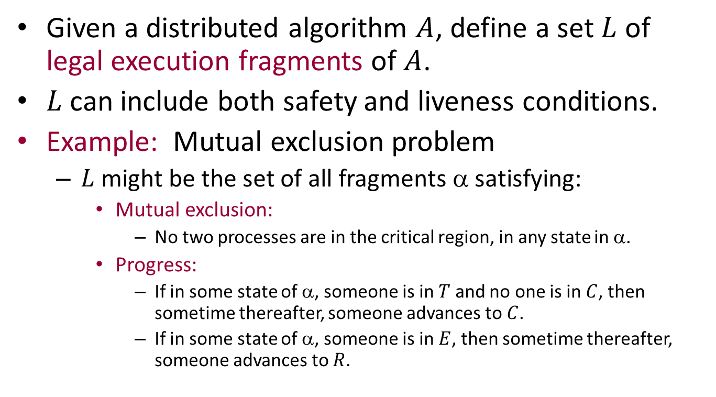
Legal execution fragments
Given a distributed algorithm $A$, define a set $L$ of legal execution fragments of $A$.
$L$ can include both safety and liveness conditions.
Example: Mutual exclusion problem
  $L$ might be the set of all fragments α satisfying:
    Mutual exclusion:
      No two processes are in the critical region, in any state in α.
    Progress:
      If in some state of α, someone is in $T$ and no one is in $C$, then sometime thereafter, someone advances to $C$.
      If in some state of α, someone is in $E$, then sometime thereafter, someone advances to $R$.
Notes:
Is it useful to divide L into safety and liveness conditions, LS and LL?
Perhaps we might require that the entire fragment is in LL, but that some suffix is in LS. ???

Slide 8
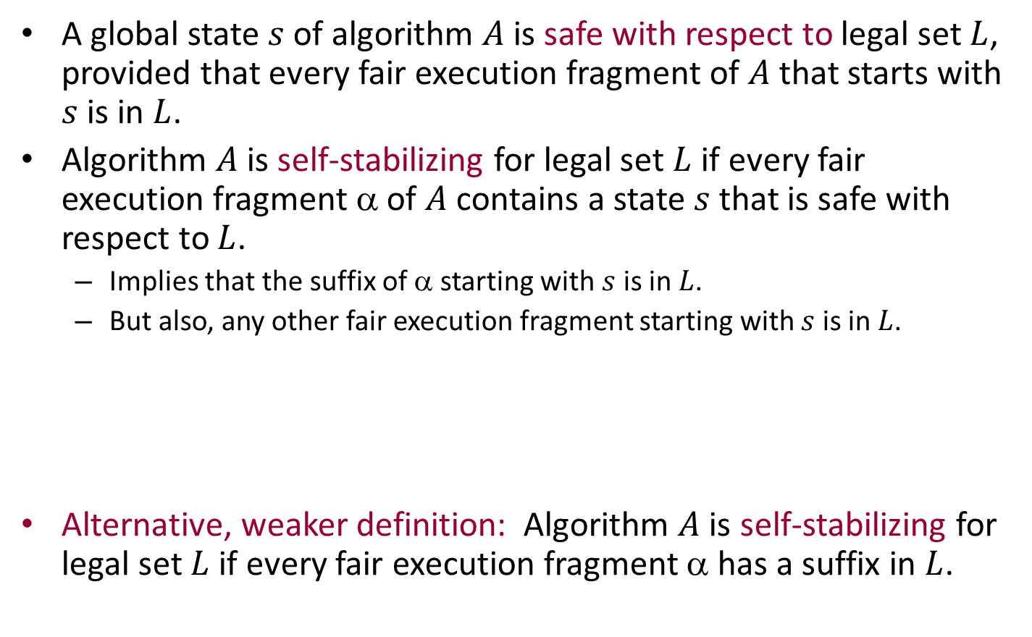
Self-stabilization: Definition
A global state $s$ of algorithm $A$ is safe with respect to legal set $L$, provided that every fair execution fragment of $A$ that starts with $s$ is in $L$.
Algorithm $A$ is self-stabilizing for legal set $L$ if every fair execution fragment α of $A$ contains a state $s$ that is safe with respect to $L$.
  Implies that the suffix of α starting with $s$ is in $L$.
  But also, any other fair execution fragment starting with $s$ is in $L$.
Alternative, weaker definition: Algorithm $A$ is self-stabilizing for legal set $L$ if every fair execution fragment α has a suffix in $L$.
α
In L
s
α
In L

Slide 9
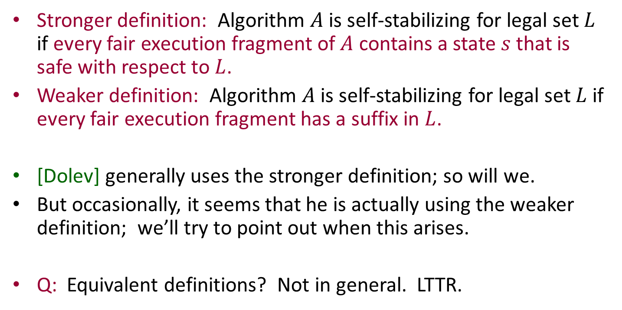
Stronger vs. weaker definition of self-stabilization
Stronger definition: Algorithm $A$ is self-stabilizing for legal set $L$ if every fair execution fragment of $A$ contains a state $s$ that is safe with respect to $L$.
Weaker definition: Algorithm $A$ is self-stabilizing for legal set $L$ if every fair execution fragment has a suffix in $L$.
[Dolev] generally uses the stronger definition; so will we.
But occasionally, it seems that he is actually using the weaker definition; we’ll try to point out when this arises.
Q: Equivalent definitions? Not in general. LTTR.
Notes:
Example to show the difference between the two definitions: (check this)
Let L = set of exec fragments that contain infinitely many outputs of “a” and no outputs of “b”.
Suppose A, started from any state, is allowed to output only finitely many b’s (every state has a counter of remaining b’s it’s allowed to output).
A chooses nondeterministically at each step whether to output b or a. But when it outputs b, it counts down the number of remaining b’s it is allowed to output.
Then A is SS w.r.t. the weaker definition: Every fair execution fragment has a suffix with infinitely many a’s and no b’s (since the entire fragment can contain only finitely many b’s).
However, A is not SS w.r.t. the stronger definition: Consider a fair execution fragment that starts from a state with b-counter > 0, and that always outputs a. It always has the possibility of outputting b in the future.
So no state is ever safe.

Slide 10
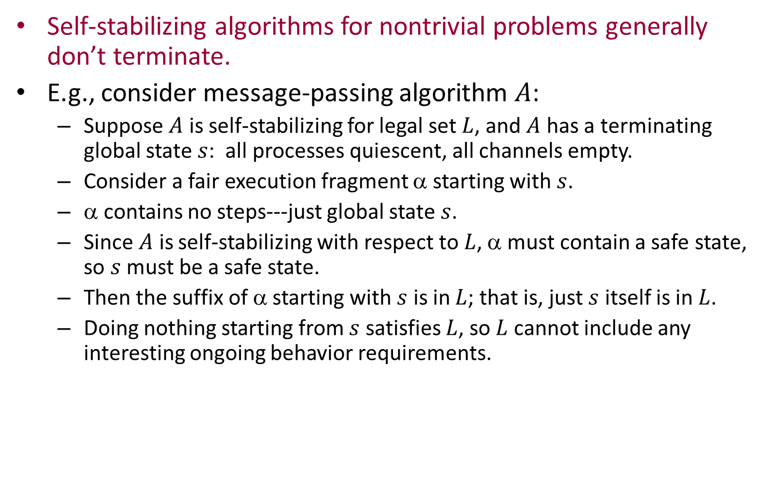
Non-termination
Self-stabilizing algorithms for nontrivial problems generally don’t terminate.
E.g., consider message-passing algorithm $A$:
  Suppose $A$ is self-stabilizing for legal set $L$, and $A$ has a terminating global state $s$: all processes quiescent, all channels empty.
  Consider a fair execution fragment α starting with $s$.
  α contains no steps---just global state $s$.
  Since $A$ is self-stabilizing with respect to $L$, α must contain a safe state, so $s$ must be a safe state.
  Then the suffix of α starting with $s$ is in $L$; that is, just $s$ itself is in $L$.
  Doing nothing starting from $s$ satisfies $L$, so $L$ cannot include any interesting ongoing behavior requirements.
Notes:
This isn’t a theorem or proof. Just shows odd facts about behavior of a terminating ss algorithm.
Also note: From state s, no one does anything to check consistency with states of other nodes, which seems odd, and rules out most interesting behavior.
Similar observations for shared-memory algorithms.

Slide 11
Self-Stabilizing Breadth-First Spanning Tree Algorithm
P₁
r₁₂
r₂₁
P₂
r₃₁
r₁₃
r₂₄
P₃
r₄₂
P₄

Slide 12
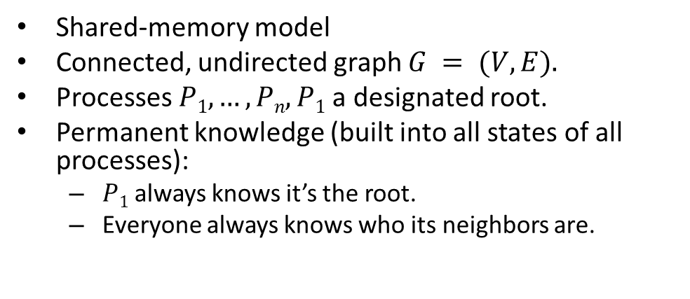
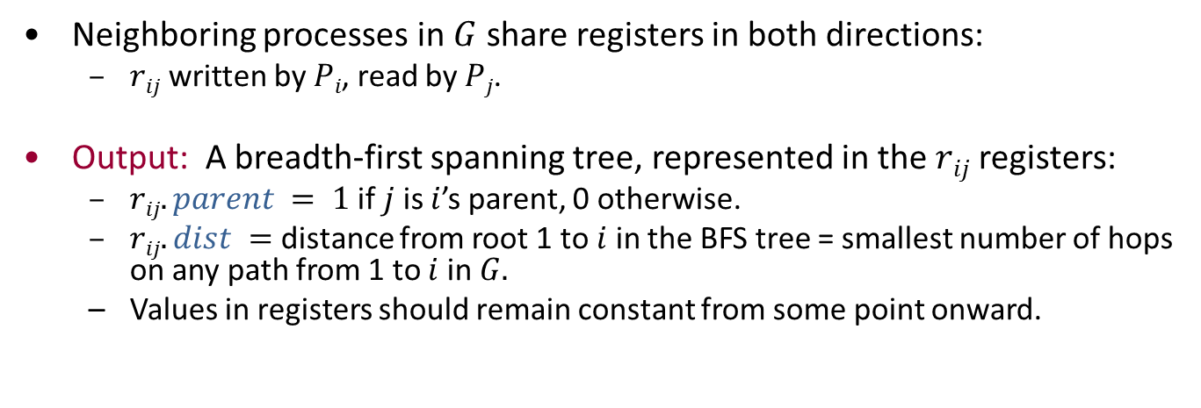
Breadth-first spanning tree
Shared-memory model
Connected, undirected graph $G = (V,E).$
Processes $P1,…,Pn, P1$a designated root.
Permanent knowledge (built into all states of all processes):
  $P1$ always knows it’s the root.
  Everyone always knows who its neighbors are.
P₁
r₁₂
r₂₁
P₂
r₃₁
r₁₃
r₂₄
P₃
r₄₂
P₄
Neighboring processes in $G$ share registers in both directions:
  $rij$written by $Pi$, read by $Pj$.
Output: A breadth-first spanning tree, represented in the $rij$ registers:
  $rij.parent = 1$if $j$ is $i$’s parent, 0 otherwise.
  $rij.dist =$ distance from root 1 to $i$ in the BFS tree = smallest number of hops on any path from 1 to $i$ in $G.$
  Values in registers should remain constant from some point onward.
Notes:
To model info that is never lost, assume it is built into ALL states of the processes.
The shared registers are like point-to-point channels, only a bit stronger (no delays).

Slide 13
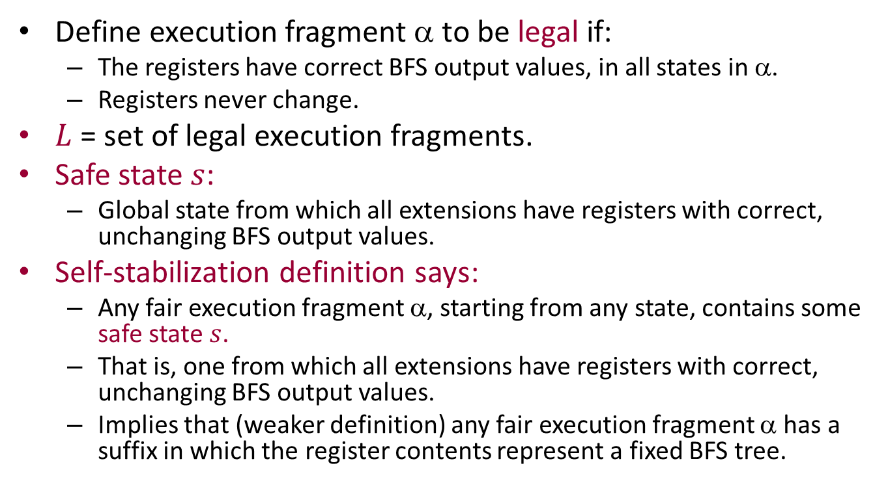
Formally, in terms of legal sets…
Define execution fragment α to be legal if:
  The registers have correct BFS output values, in all states in α.
  Registers never change.
$L$ = set of legal execution fragments.
Safe state $s$:
  Global state from which all extensions have registers with correct, unchanging BFS output values.
Self-stabilization definition says:
  Any fair execution fragment α, starting from any state, contains some safe state $s$.
  That is, one from which all extensions have registers with correct, unchanging BFS output values.
  Implies that (weaker definition) any fair execution fragment α has a suffix in which the register contents represent a fixed BFS tree.
Notes:
The implication at the end corresponds to the weaker definition.

Slide 14
BFS Algorithm strategy
The system may start in any state, with
  Any values (of the allowed types) in the registers,
  Any values in local process variables.
Processes can’t assume that their own states and output registers are initially correct.
P₁
r₁₂
r₂₁
P₂
r₃₁
r₁₃
r₂₄
P₃
r₄₂
P₄
Repeatedly recalculate states and outputs based on inputs from neighbors.
In case of a tie, use some default rule for selecting the parent.
Prove correctness, stabilization time, using induction on the actual distance from the root.

Slide 15
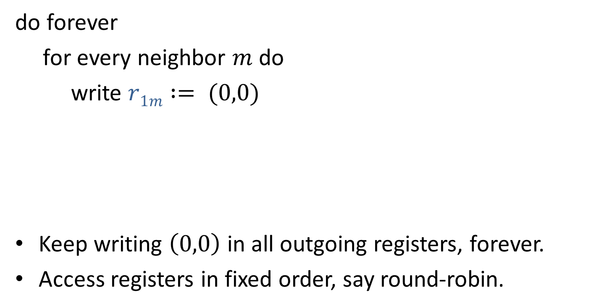

Root process $P1$
do forever
for every neighbor $m$ do
write $r1m := (0,0)$
Keep writing $\left(0,0\right)$ in all outgoing registers, forever.
Access registers in fixed order, say round-robin.
You’re not my parent
My distance from root

Slide 16

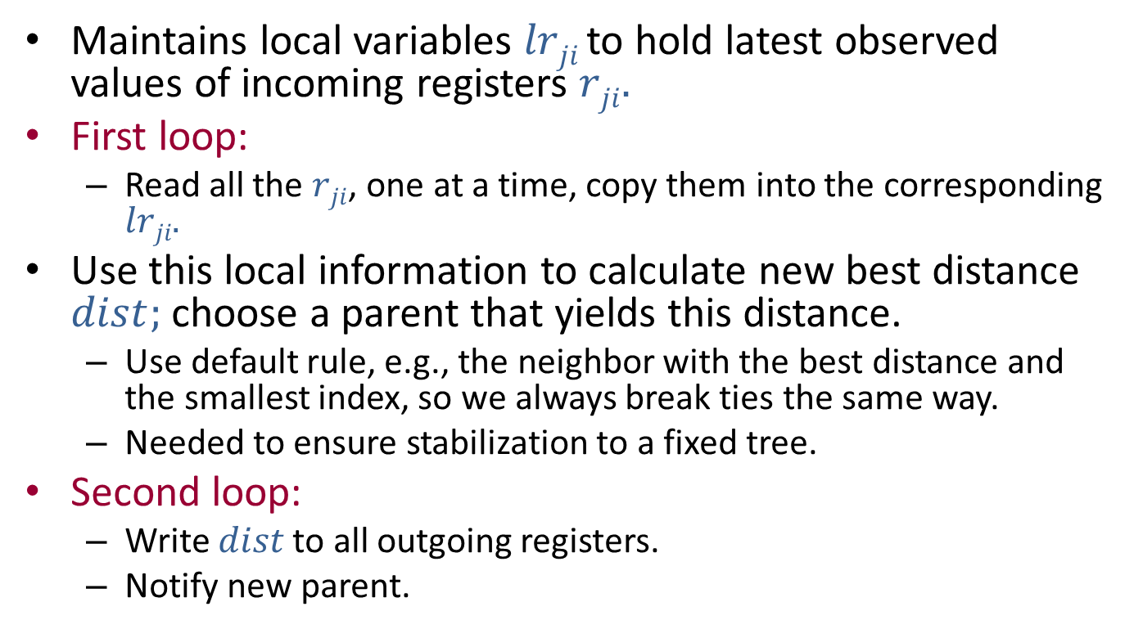
Non-root process $Pi$
Maintains local variables $lrji$ to hold latest observed values of incoming registers $rji.$
First loop:
  Read all the $rji$, one at a time, copy them into the corresponding $lrji.$
Use this local information to calculate new best distance $dist;$ choose a parent that yields this distance.
  Use default rule, e.g., the neighbor with the best distance and the smallest index, so we always break ties the same way.
  Needed to ensure stabilization to a fixed tree.
Second loop:
  Write $dist$to all outgoing registers.
  Notify new parent.
Notes:
We’re notifying the new parent that he is the parent.

Slide 17

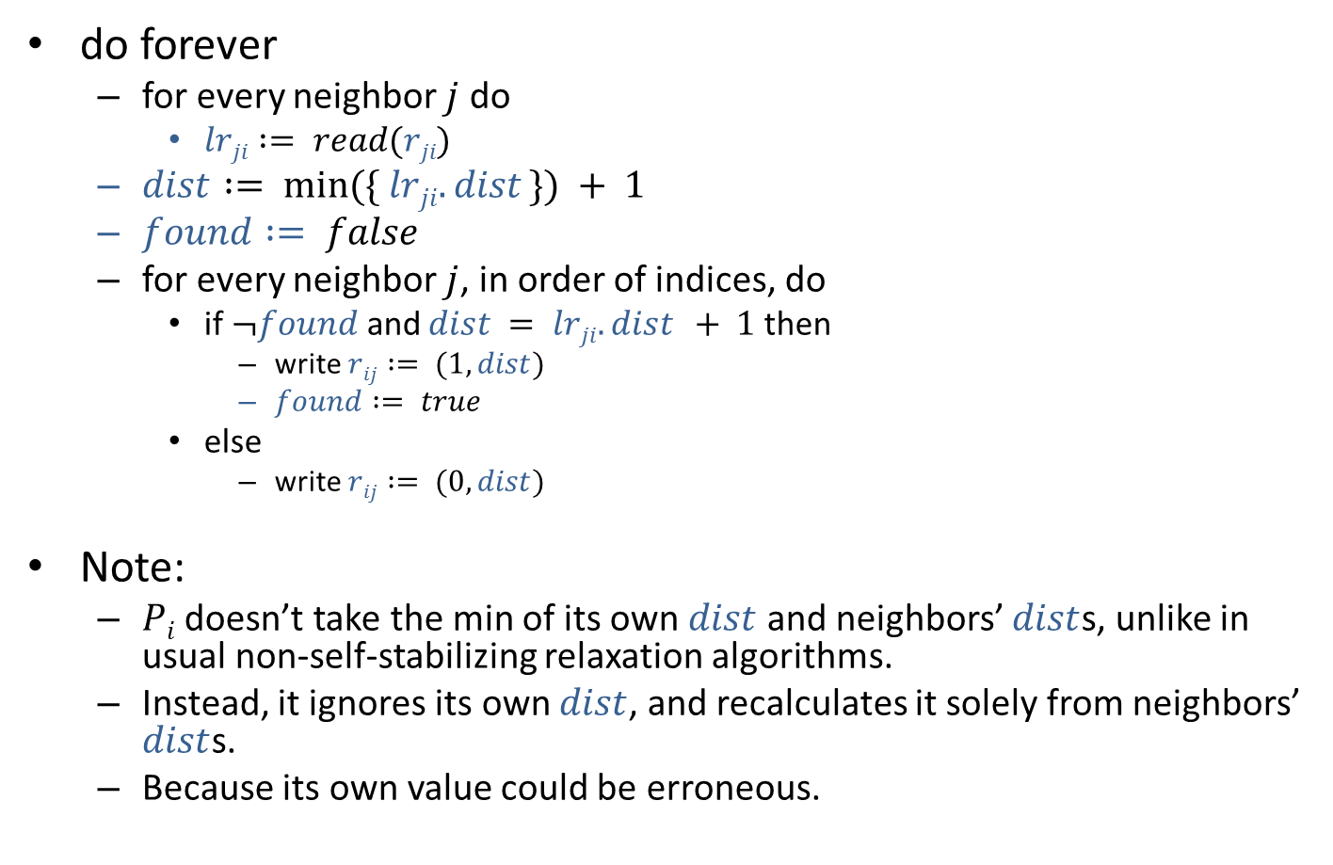
Non-root process $Pi$
do forever
  for every neighbor $j$ do
    $lrji := read(rji)$
  $dist := min⁡(\{ lrji.dist \}) + 1$
  $found := false$
  for every neighbor $j$, in order of indices, do
    if $¬found$ and $dist = lrji.dist + 1$then
      write $rij := (1,dist)$
      $found := true$
    else
      write $rij := (0,dist)$
Note:
  $Pi$ doesn’t take the min of its own $dist$ and neighbors’ $dist$s, unlike in usual non-self-stabilizing relaxation algorithms.
  Instead, it ignores its own $dist$, and recalculates it solely from neighbors’ $dist$s.
  Because its own value could be erroneous.

Slide 18
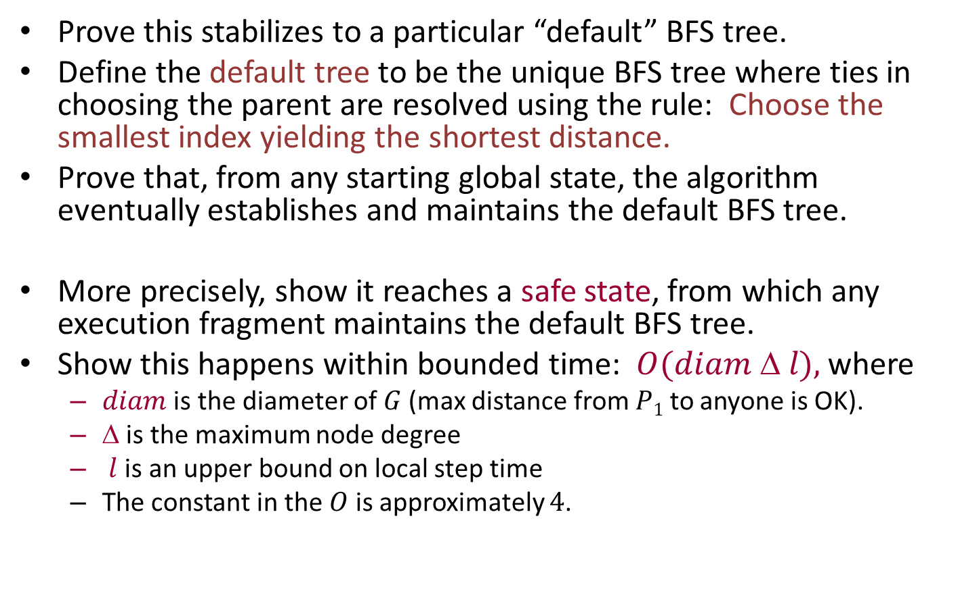
Correctness
Prove this stabilizes to a particular “default” BFS tree.
Define the default tree to be the unique BFS tree where ties in choosing the parent are resolved using the rule: Choose the smallest index yielding the shortest distance.
Prove that, from any starting global state, the algorithm eventually establishes and maintains the default BFS tree.
More precisely, show it reaches a safe state, from which any execution fragment maintains the default BFS tree.
Show this happens within bounded time: $O(diam  l),$where
  $diam$ is the diameter of $G$(max distance from $P1$ to anyone is OK).
  $$ is the maximum node degree
  $l$ is an upper bound on local step time
  The constant in the $O$ is approximately $4$.

Slide 19
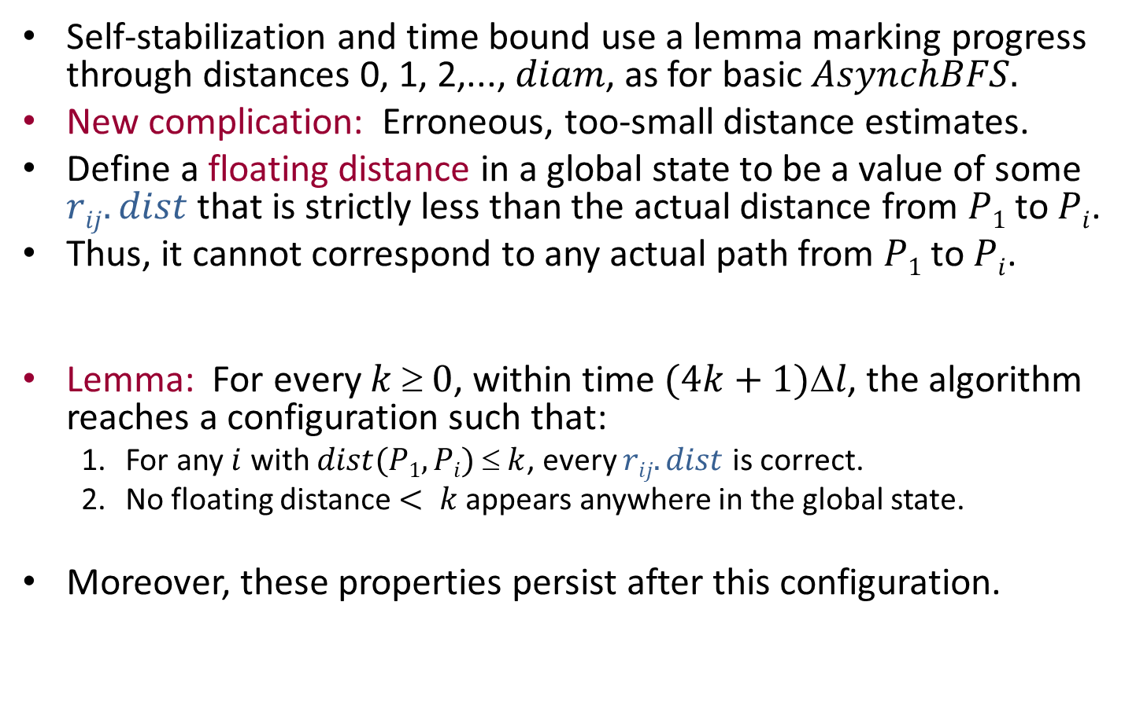
Correctness
Self-stabilization and time bound use a lemma marking progress through distances 0, 1, 2,..., $diam$, as for basic $AsynchBFS.$
New complication: Erroneous, too-small distance estimates.
Define a floating distance in a global state to be a value of some $rij.dist$ that is strictly less than the actual distance from $P1$ to $Pi$.
Thus, it cannot correspond to any actual path from $P1$ to $Pi$.
Lemma: For every $k$≥$0$, within time $(4k+1)l$, the algorithm reaches a configuration such that:
  For any $i$ with $dist(P1,Pi)  k$, every $rij.dist$ is correct.
  No floating distance $< k$appears anywhere in the global state.
Moreover, these properties persist after this configuration.

Slide 20
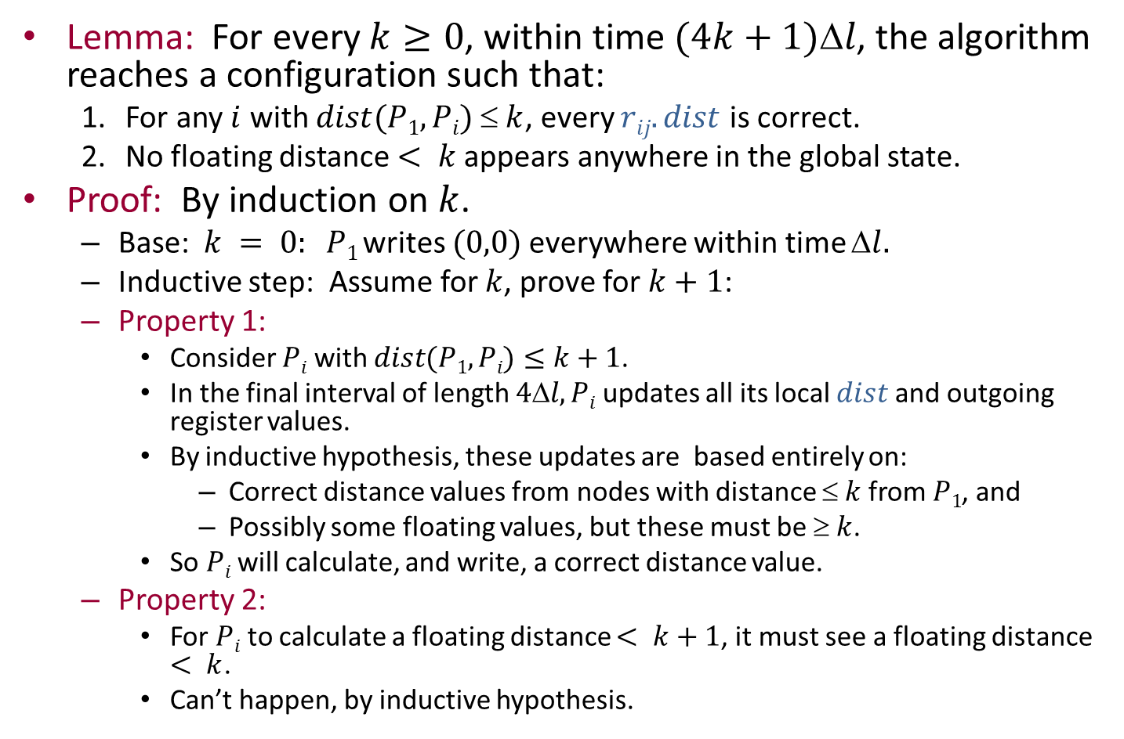
Proof of Lemma
Lemma: For every $k≥0$, within time $(4k+1)l$, the algorithm reaches a configuration such that:
  For any $i$ with $dist(P1,Pi)  k$, every $rij.dist$ is correct.
  No floating distance $< k$appears anywhere in the global state.
Proof: By induction on $k$.
  Base:$k = 0: P1$writes $(0,0)$everywhere within time $l.$
  Inductive step: Assume for $k$, prove for $k+1$:
  Property 1:
    Consider $Pi$ with $dist(P1,Pi)≤$ $k+1$.
    In the final interval of length $4l,Pi$updates all its local $dist$and outgoing register values.
    By inductive hypothesis, these updates are based entirely on:
      Correct distance values from nodes with distance $ k$from $P1$, and
      Possibly some floating values, but these must be $ k$.
    So $Pi$ will calculate, and write, a correct distance value.
  Property 2:
    For $Pi$ to calculate a floating distance $< k+1$, it must see a floating distance $< k$.
    Can’t happen, by inductive hypothesis.

Slide 21
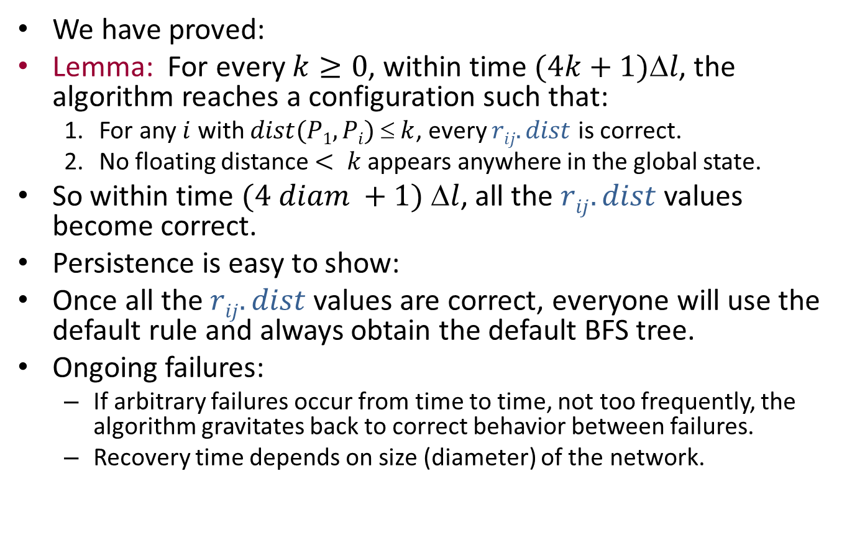
Proof, cont’d
We have proved:
Lemma: For every $k≥0$, within time $(4k+1)l$, the algorithm reaches a configuration such that:
  For any $i$ with $dist(P1,Pi)  k$, every $rij.dist$ is correct.
  No floating distance $< k$appears anywhere in the global state.
So within time $(4 diam +1) l$, all the $rij.dist$ values become correct.
Persistence is easy to show:
Once all the $rij.dist$ values are correct, everyone will use the default rule and always obtain the default BFS tree.
Ongoing failures:
  If arbitrary failures occur from time to time, not too frequently, the algorithm gravitates back to correct behavior between failures.
  Recovery time depends on size (diameter) of the network.
Notes:
We had a similar problem in the second homework assignment, but for the synchronous network model and weighted graphs.

Slide 22
Self-Stabilizing Mutual Exclusion Algorithm
x₁
x_{n}
P₁
x₂
P_{n}
P₂
P₃
x₃

Slide 23
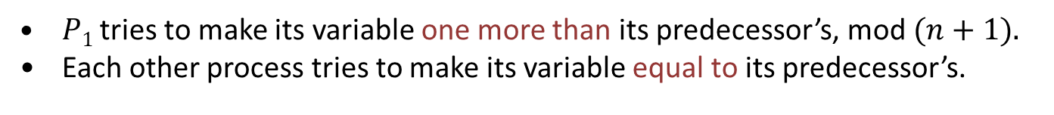
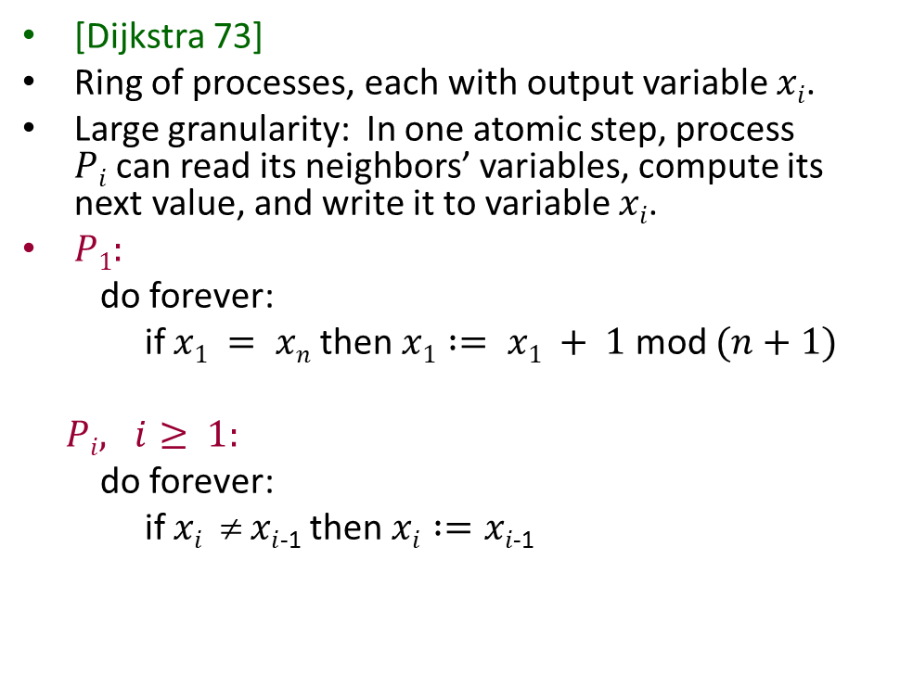

Self-stabilizing mutual exclusion
[Dijkstra 73]
Ring of processes, each with output variable $xi$.
Large granularity: In one atomic step, process $Pi$can read its neighbors’ variables, compute its next value, and write it to variable $xi$.
$P1:$
do forever:
if $x1 = xn$then $x1 := x1 + 1$mod $(n+1)$
$Pi, i≥ 1:$
do forever:
if $xi$ ≠ $xi$₋₁ then $xi :=xi\text{−1}$
x₁
x_{n}
P₁
x₂
P_{n}
P₂
$n+1,$not $n$.
P₃
x₃
$P1$ tries to make its variable one more than its predecessor’s, mod $(n+1).$
Each other process tries to make its variable equal to its predecessor’s.

Slide 24
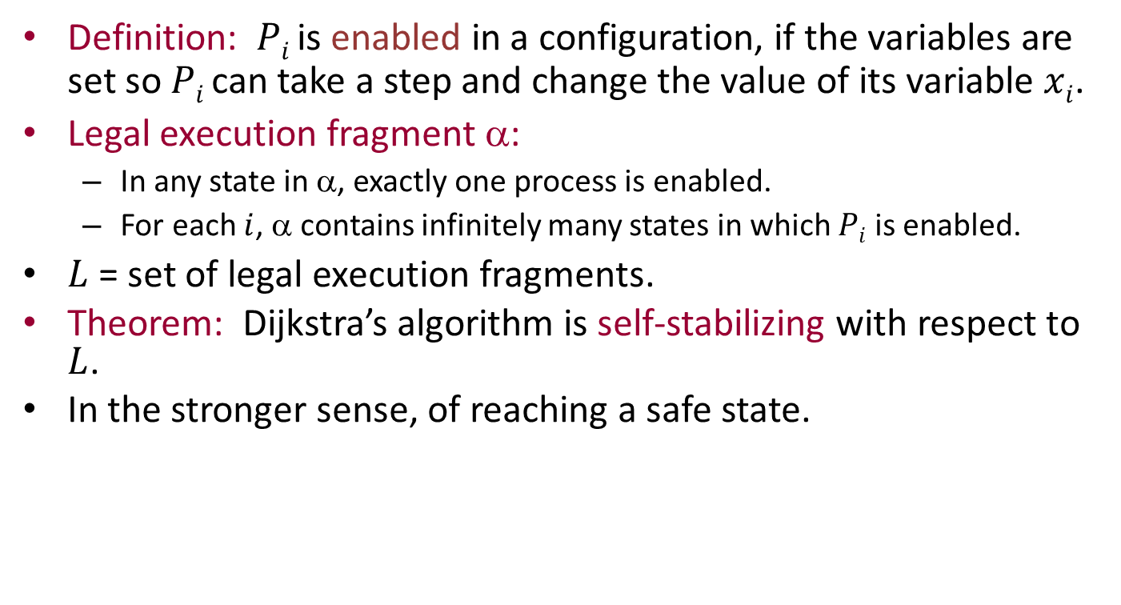
Self-stabilization result
Definition: $Pi$ is enabled in a configuration, if the variables are set so $Pi$can take a step and change the value of its variable $xi$.
Legal execution fragment α:
  In any state in α, exactly one process is enabled.
  For each $i$, α contains infinitely many states in which $Pi$ is enabled.
$L$= set of legal execution fragments.
Theorem: Dijkstra’s algorithm is self-stabilizing with respect to $L$.
In the stronger sense, of reaching a safe state.

Slide 25
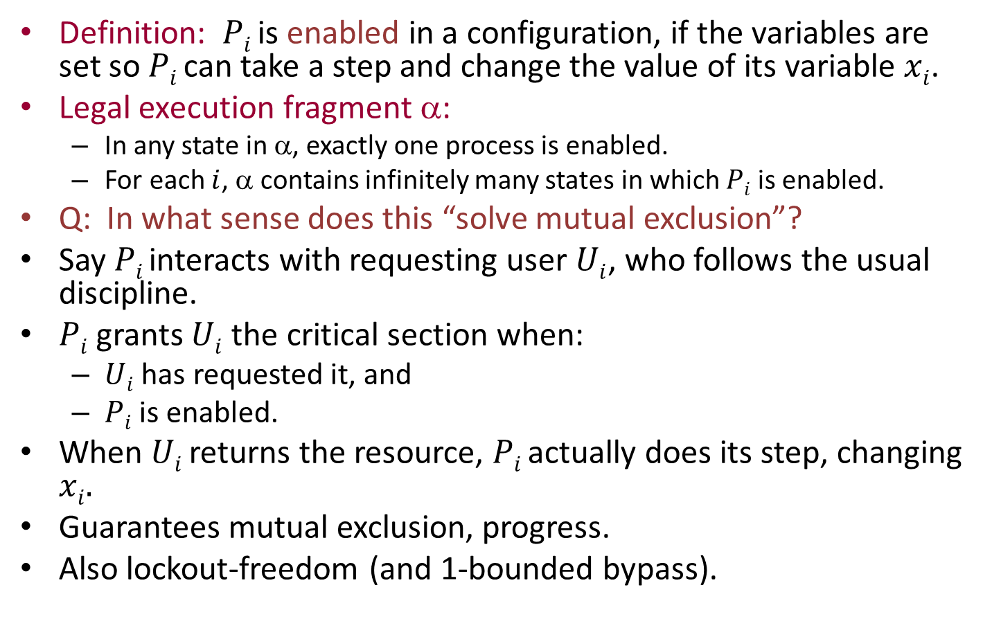
Mutual exclusion?
Definition: $Pi$ is enabled in a configuration, if the variables are set so $Pi$can take a step and change the value of its variable $xi$.
Legal execution fragment α:
  In any state in α, exactly one process is enabled.
  For each $i$, α contains infinitely many states in which $Pi$ is enabled.
Q: In what sense does this “solve mutual exclusion”?
Say $Pi$ interacts with requesting user $Ui$, who follows the usual discipline.
$Pi$ grants $Ui$ the critical section when:
  $Ui$ has requested it, and
  $Pi$is enabled.
When $Ui$ returns the resource, $Pi$ actually does its step, changing $xi.$
Guarantees mutual exclusion, progress.
Also lockout-freedom (and 1-bounded bypass).
Notes:
The guarantees for mutual exclusion are stated loosely here.
To interpret them formally, define L’ to be the legal set for mutual exclusion, defined on an earlier slide.
Assume we satisfy SS w.r.t. L defined on this slide, in the weaker sense (in each execution, we reach a point after which these two conditions hold).
Then in each execution, after some possibly-later point, any critical-region conflicts have been removed (we assume that the user eventually does return from the critical region). And thereafter, we get the two mutex conditions: no conflicting grants, and everyone gets a turn infinitely often.
What about the strong version of this? Assume that we satisfy SS w.r.t. L in the stronger sense: in each execution, eventually we reach a safe state. Then in that same execution, we eventually reach a state that resolves the critical-region conflicts. That state should be safe w.r.t. L’, the mutual exclusion legal set.
We could define stronger liveness conditions, and redefine the mutex legal set L’ accordingly. That would yield new claims of self-stabilization (both weak and strong) for this mutex algorithm, based on this new L’.

Slide 26
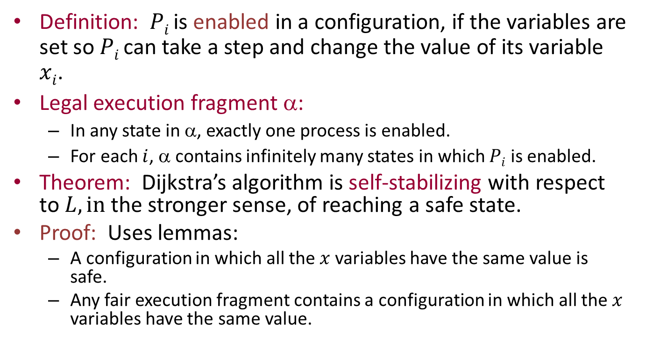
Proof of self-stabilization
Definition: $Pi$ is enabled in a configuration, if the variables are set so $Pi$can take a step and change the value of its variable $xi$.
Legal execution fragment α:
  In any state in α, exactly one process is enabled.
  For each $i$, α contains infinitely many states in which $Pi$ is enabled.
Theorem: Dijkstra’s algorithm is self-stabilizing with respect to $L, in$the stronger sense, of reaching a safe state.
Proof: Uses lemmas:
  A configuration in which all the $x$ variables have the same value is safe.
  Any fair execution fragment contains a configuration in which all the $x$ variables have the same value.

Slide 27
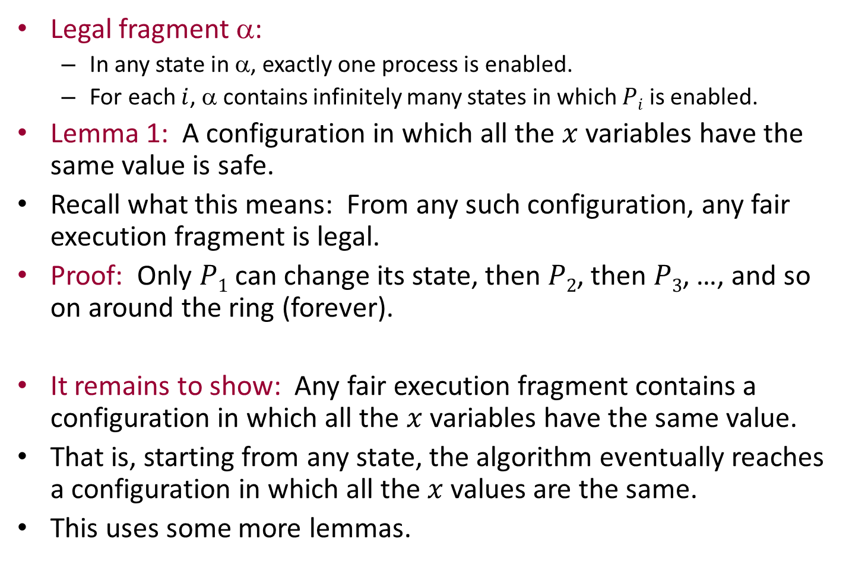
Lemma 1
Legal fragment α:
  In any state in α, exactly one process is enabled.
  For each $i$, α contains infinitely many states in which $Pi$ is enabled.
Lemma 1: A configuration in which all the $x$ variables have the same value is safe.
Recall what this means: From any such configuration, any fair execution fragment is legal.
Proof: Only $P1$ can change its state, then $P2$, then $P3$, …, and so on around the ring (forever).
  It remains to show: Any fair execution fragment contains a configuration in which all the $x$ variables have the same value.
That is, starting from any state, the algorithm eventually reaches a configuration in which all the $x$ values are the same.
This uses some more lemmas.

Slide 28
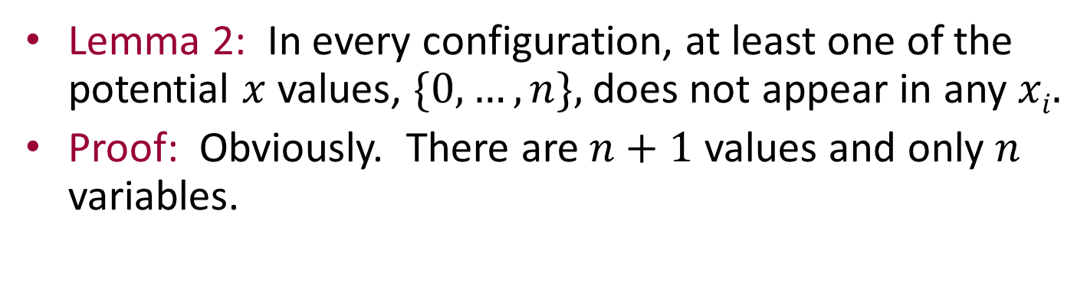
Lemma 2
Lemma 2: In every configuration, at least one of the potential $x$values, $\{0,…,n\},$does not appear in any $xi.$
Proof: Obviously. There are $n+1$ values and only $n$ variables.

Slide 29
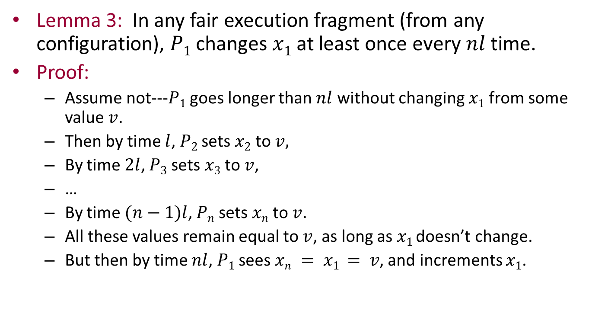
Lemma 3
Lemma 3: In any fair execution fragment (from any configuration), $P1$ changes $x1$at least once every $nl$time.
Proof:
  Assume not---$P1$ goes longer than $nl$ without changing $x1$from some value $v$.
  Then by time $l$, $P2$ sets $x2$ to $v,$
  By time $2l$, $P3$ sets $x3$ to $v$,
  …
  By time $(n−1)l$, $Pn$ sets $xn$ to $v$.
  All these values remain equal to $v$, as long as $x1$ doesn’t change.
  But then by time $nl$, $P1$sees $xn = x1 = v$, and increments $x1$.
Notes:
The ell here is an upper bound on local step time. Within time ell after someone makes a change, its clockwise neighbor will take a step and act on the new change.

Slide 30
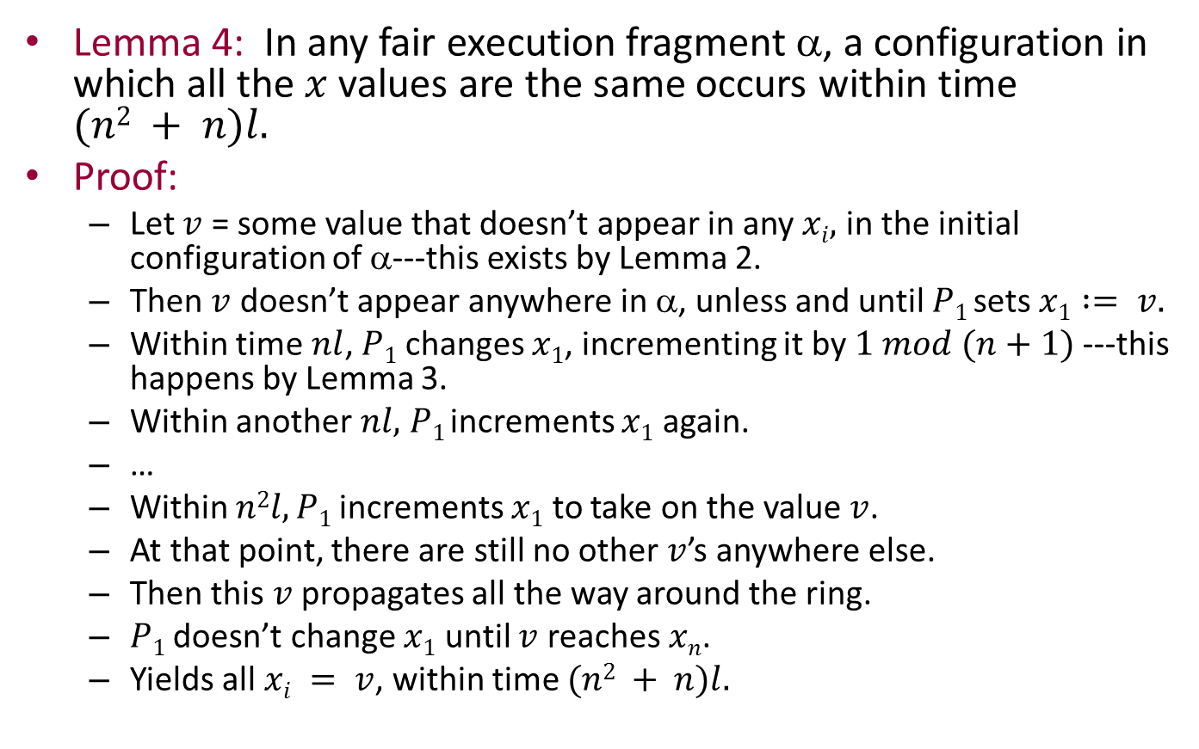
Lemma 4
Lemma 4: In any fair execution fragment α, a configuration in which all the $x$ values are the same occurs within time $(n2 + n)l.$
Proof:
  Let $v$ = some value that doesn’t appear in any $xi,$ in the initial configuration of α---this exists by Lemma 2.
  Then $v$ doesn’t appear anywhere in α, unless and until $P1$ sets $x1 := v.$
  Within time $nl$, $P1$ changes $x1$, incrementing it by $1 mod (n+1)$---this happens by Lemma 3.
  Within another $nl,$ $P1$ increments $x1$ again.
  …
  Within $n2l, P1$increments $x1$ to take on the value $v$.
  At that point, there are still no other $v$’s anywhere else.
  Then this $v$propagates all the way around the ring.
  $P1$ doesn’t change $x1$ until $v$ reaches $xn$.
  Yields all $xi = v$, within time $(n2 + n)l.$

Slide 31
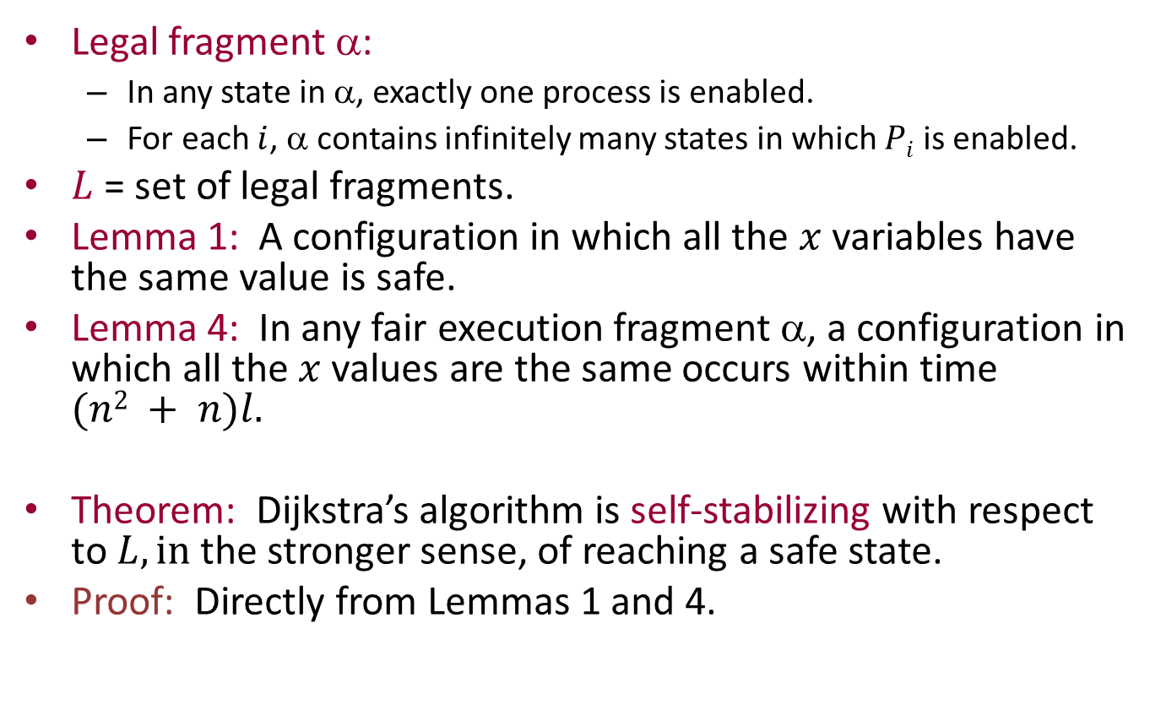
Putting the pieces together
Legal fragment α:
  In any state in α, exactly one process is enabled.
  For each $i$, α contains infinitely many states in which $Pi$ is enabled.
$L$ = set of legal fragments.
Lemma 1: A configuration in which all the $x$ variables have the same value is safe.
Lemma 4: In any fair execution fragment α, a configuration in which all the $x$ values are the same occurs within time $(n2 + n)l.$
Theorem: Dijkstra’s algorithm is self-stabilizing with respect to $L, in$the stronger sense, of reaching a safe state.
Proof: Directly from Lemmas 1 and 4.

Slide 32
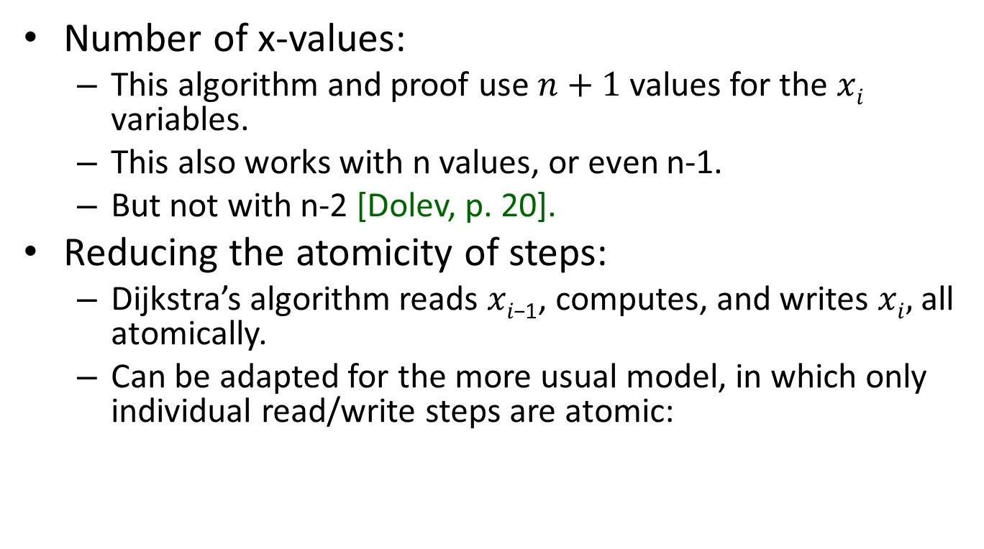
Remarks
Number of x-values:
  This algorithm and proof use $n+1$ values for the $xi$ variables.
  This also works with n values, or even n-1.
  But not with n-2 [Dolev, p. 20].
Reducing the atomicity of steps:
  Dijkstra’s algorithm reads $xi\text{−1}$, computes, and writes $xi,$ all atomically.
  Can be adapted for the more usual model, in which only individual read/write steps are atomic:

Slide 33
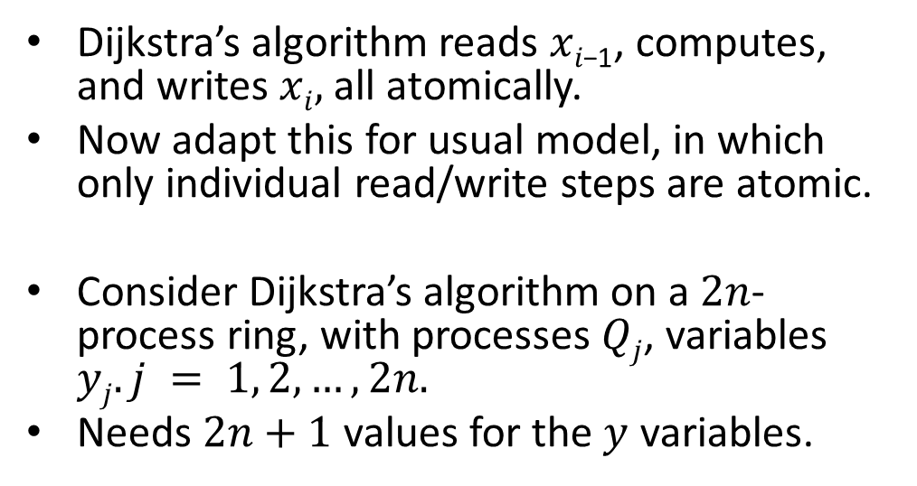
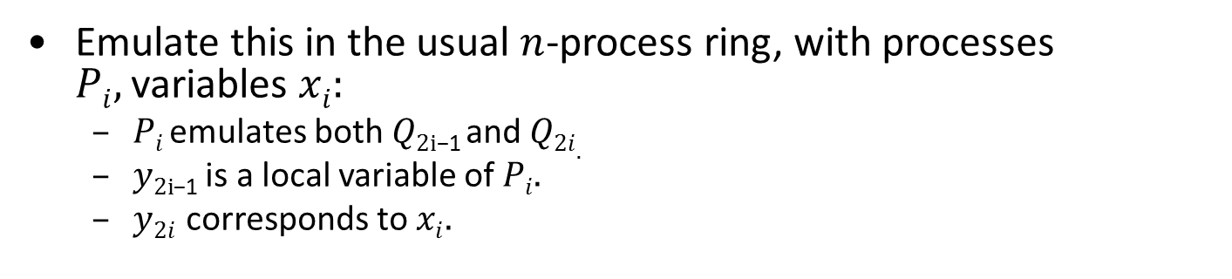
Reducing the atomicity
x₁
Dijkstra’s algorithm reads $xi\text{−1}$, computes, and writes $xi,$ all atomically.
Now adapt this for usual model, in which only individual read/write steps are atomic.
Consider Dijkstra’s algorithm on a $2n$-process ring, with processes $Qj$, variables $yj. j = 1, 2, …, 2n.$
Needs $2n+1$ values for the $y$ variables.
x_{n}
P₁
x₂
P_{n}
P₂
P₃
x₃
Emulate this in the usual $n$-process ring, with processes $Pi,$variables $xi:$
  $Pi$ emulates both$Q\text{2}\text{i}\text{−1}$ and $Q2i.$
  $y\text{2}\text{i}\text{−1}$ is a local variable of $Pi.$
  $y2i$ corresponds to $xi.$
Notes:
The P-x ring has only individual read/write steps being atomic.

Slide 34
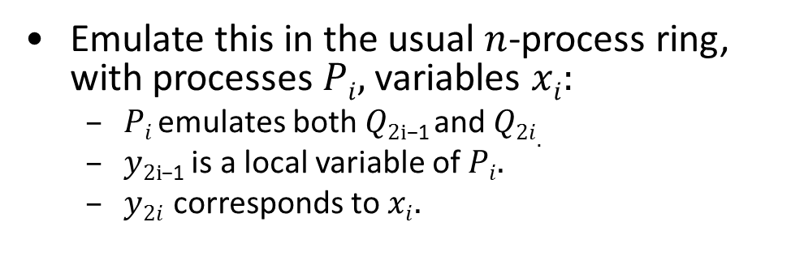

Reducing the atomicity
x₁
Emulate this in the usual $n$-process ring, with processes $Pi,$variables $xi:$
  $Pi$ emulates both$Q\text{2}\text{i}\text{−1}$ and $Q2i.$
  $y\text{2}\text{i}\text{−1}$ is a local variable of $Pi.$
  $y2i$ corresponds to $xi.$
x_{n}
P₁
x₂
P_{n}
P₂
P₃
x₃
To emulate a step of $Q\text{2}\text{i}\text{−1}$, $Pi$ reads from $xi\text{−1}$, writes to its local variable $y\text{2}\text{i}\text{−1}$.
To emulate a step of $Q2i,Pi$ reads from its local variable $y\text{2}\text{i}\text{−1}$, writes to $xi.$
Since in each case one variable is internal, $Pi$can emulate each step with just one ordinary read or write to shared memory.
Notes:
What does this emulation guarantee?
Needs a slight redefinition of the correctness conditions.
Now we would define “enabling” to mean that the process is able either to write one of its two y variables.
Then we can again claim that, in any state, exactly one process is enabled, and also, every process gets enabled infinitely often.
Correctness conditions for the emulated algorithm carry over to the algorithm produced by the emulation.

Slide 35
Composing Self-Stabilizing Algorithms
P₁
P₂
P₃
P₄
P₅

Slide 36
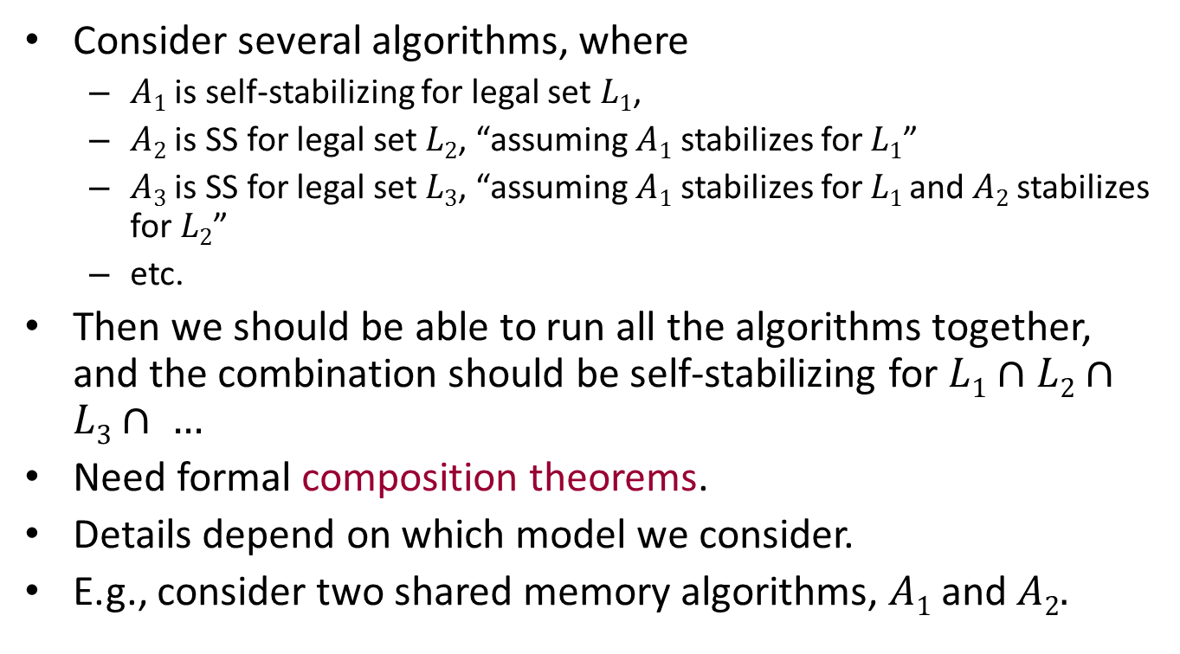
Composing self-stabilizing algorithms
Consider several algorithms, where
  $A1$ is self-stabilizing for legal set $L1$,
  $A2$ is SS for legal set $L2$, “assuming $A1$ stabilizes for $L1$”
  $A3$ is SS for legal set $L3$, “assuming $A1$ stabilizes for $L1$ and $A2$stabilizes for $L2$”
  etc.
Then we should be able to run all the algorithms together, and the combination should be self-stabilizing for $L1∩L2∩L3∩ …$
Need formal composition theorems.
Details depend on which model we consider.
E.g., consider two shared memory algorithms, $A1$and$A2.$

Slide 37
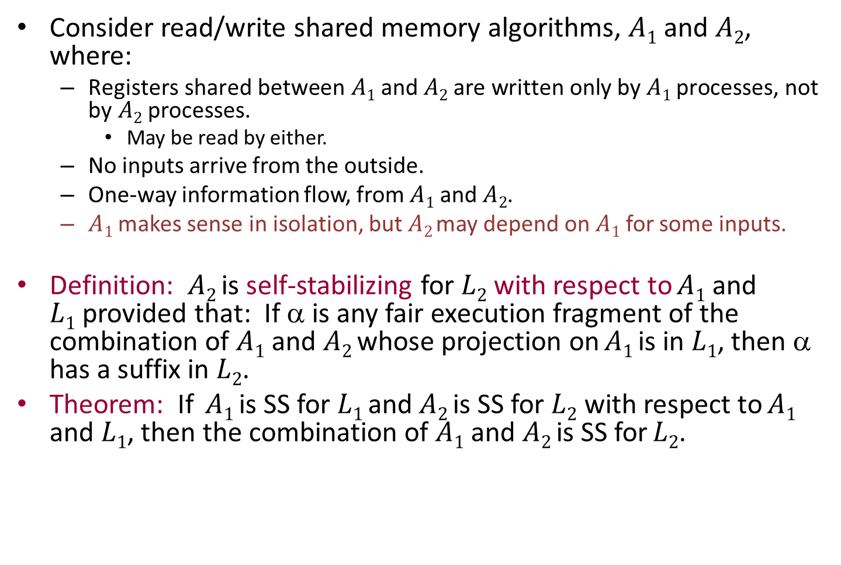
Composing SS algorithms
Consider read/write shared memory algorithms, $A1$ and $A2$, where:
  $\text{Registers} \text{shared} \text{between} A1 \text{and} A2 \text{are} \text{written} \text{only} \text{by} A1 \text{processes}\text{, }\text{not} \text{by} A2 \text{processes}\text{.}$
    May be read by either.
  No inputs arrive from the outside.
  One-way information flow, from $A1$ and $A2$.
  $A1$ makes sense in isolation, but $A2$may depend on $A1$ for some inputs.
Definition: $A2$ is self-stabilizing for $L2$ with respect to $A1$ and $L1$provided that: If α is any fair execution fragment of the combination of $A1$ and $A2$ whose projection on $A1$ is in $L1$, then α has a suffix in $L2$.
Theorem: If $A1$ is SS for $L1$ and $A2$ is SS for $L2$ with respect to $A1$ and $L1$, then the combination of $A1$and $A2$is SS for $L2$.
Notes:
Draw a picture? A1, A2, a variable between the two written by A1 and read by A2 (could be read by A1 also but it doesn’t matter).
A variable to the right of A2, written by A2 (could be read by A2 also but it doesn’t matter).
What I mean by the combination of A1 and A2 should be more-or-less obvious: Take all the processes and variables together, let all the processes take steps fairly.
The notion of projection on A1 should be obvious too---just look at the state and steps relevant to A1---including its registers.

Slide 38
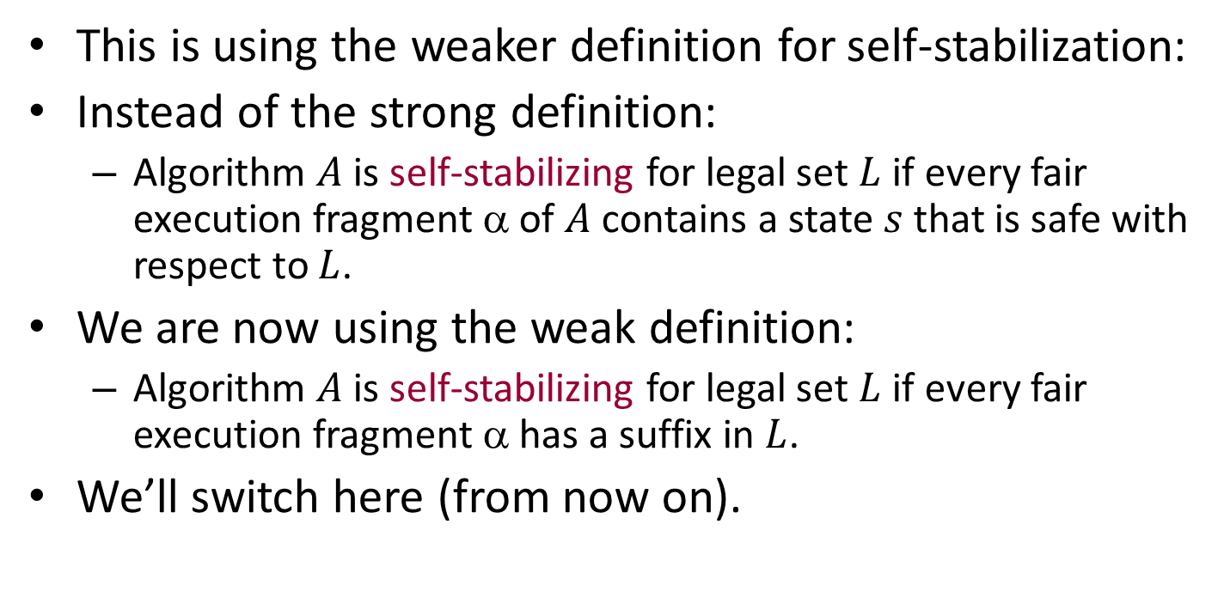
Weaker definition of self-stabilization
This is using the weaker definition for self-stabilization:
Instead of the strong definition:
  Algorithm $A$ is self-stabilizing for legal set $L$ if every fair execution fragment α of $A$ contains a state $s$ that is safe with respect to $L$.
We are now using the weak definition:
  Algorithm $A$ is self-stabilizing for legal set $L$ if every fair execution fragment α has a suffix in $L$.
We’ll switch here (from now on).

Slide 39
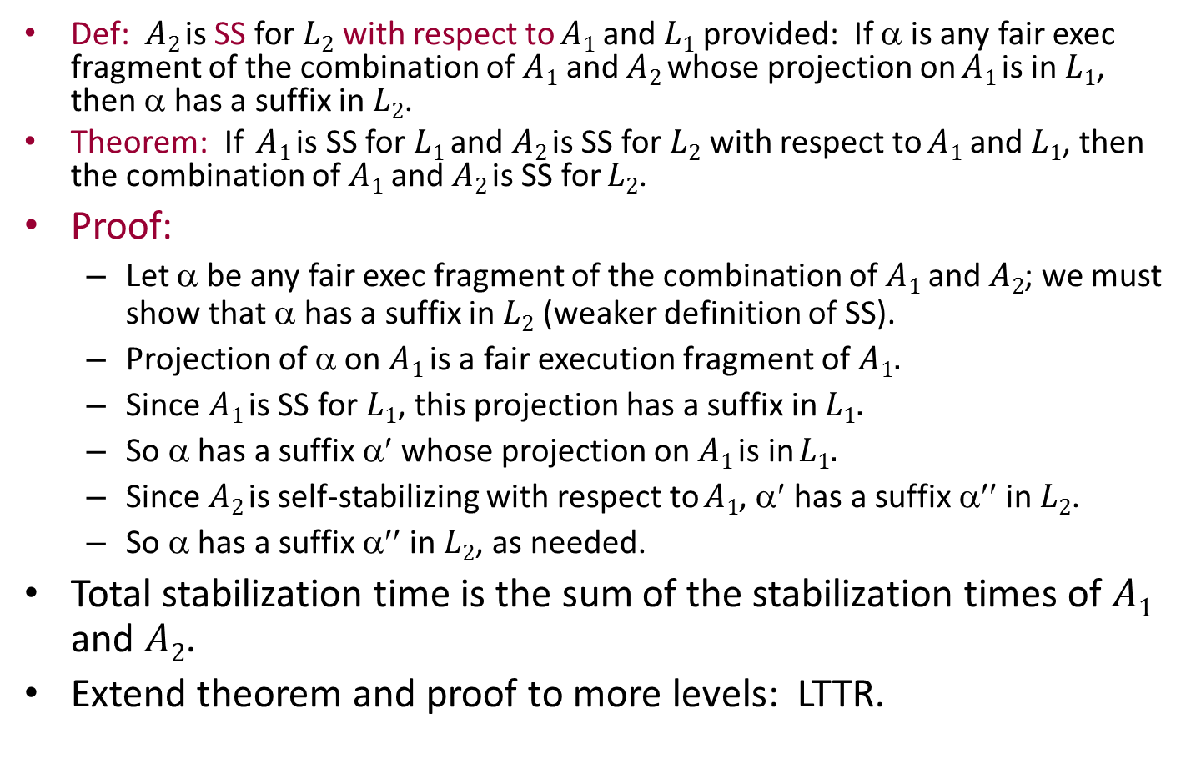
Composing SS algorithms
Def: $A2$ is SS for $L2$ with respect to $A1$ and $L1$provided: If α is any fair exec fragment of the combination of $A1$ and $A2$ whose projection on $A1$ is in $L1$, then α has a suffix in $L2$.
Theorem: If $A1$ is SS for $L1$ and $A2$ is SS for $L2$ with respect to $A1$ and $L1$, then the combination of $A1$and $A2$is SS for $L2$.
Proof:
  Let α be any fair exec fragment of the combination of $A1$and $A2$; we must show that α has a suffix in $L2$ (weaker definition of SS).
  Projection of α on $A1$ is a fair execution fragment of $A1.$
  Since $A1$ is SS for $L1$, this projection has a suffix in $L1.$
  So α has a suffix α′ whose projection on $A1$ is in $L1.$
  Since $A2$ is self-stabilizing with respect to $A1$, α′ has a suffix α′′ in $L2$.
  So α has a suffix α′′ in $L2$, as needed.
Total stabilization time is the sum of the stabilization times of $A1$ and $A2$.
Extend theorem and proof to more levels: LTTR.

Slide 40
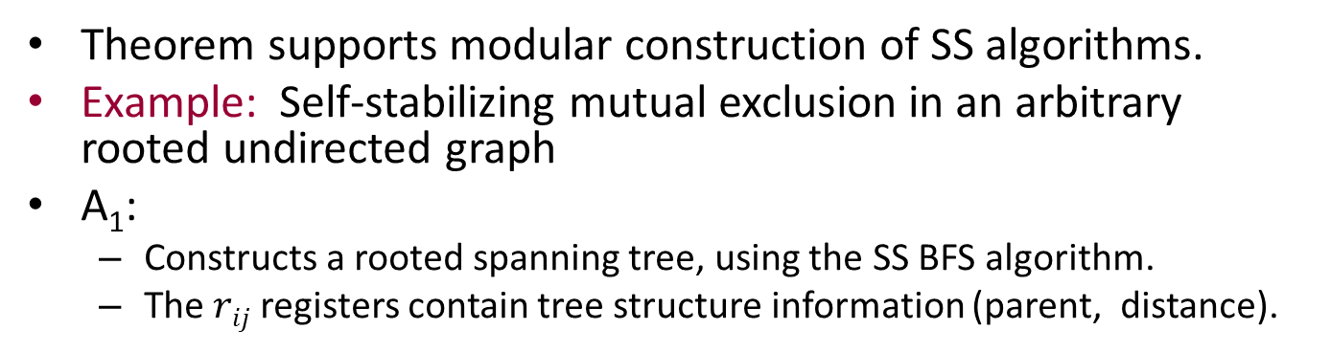
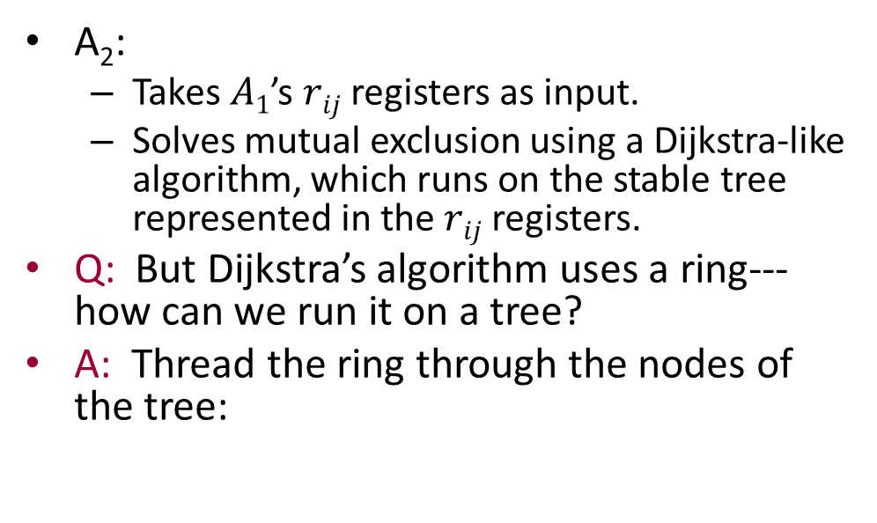
Applying the composition theorem
Theorem supports modular construction of SS algorithms.
Example: Self-stabilizing mutual exclusion in an arbitrary rooted undirected graph
A₁:
  Constructs a rooted spanning tree, using the SS BFS algorithm.
  The $rij$ registers contain tree structure information (parent, distance).
A₂:
  Takes $A1$’s $rij$ registers as input.
  Solves mutual exclusion using a Dijkstra-like algorithm, which runs on the stable tree represented in the $rij$ registers.
Q: But Dijkstra’s algorithm uses a ring---how can we run it on a tree?
A: Thread the ring through the nodes of the tree:
P₁
P₂
P₃
P₄
P₅
Notes:
What we have to work with is an undirected graph of processes with registers on both directions of the edges. Suppose that each edge can have multiple registers in both directions. Some of the registers are for the BFS algorithm A1 and the rest are for the Dijkstra algorithm A2.
Each process Pi emulates corresponding processes of the BFS algorithm A1 and the Dijkstra algorithm A2.
The processes of the BFS algorithm write their output into their own shared registers, which are read by the processes of the Dijkstra algorithm.

Slide 41
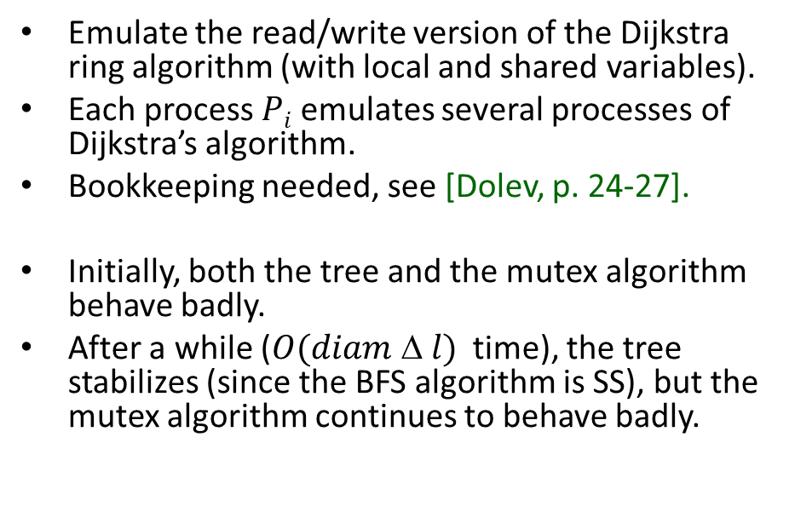
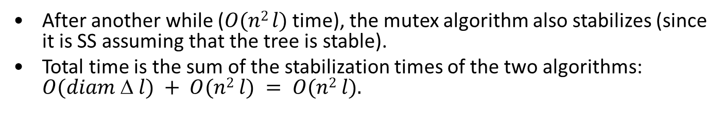
Mutual exclusion in a rooted tree
Emulate the read/write version of the Dijkstra ring algorithm (with local and shared variables).
Each process $Pi$ emulates several processes of Dijkstra’s algorithm.
Bookkeeping needed, see [Dolev, p. 24-27].
Initially, both the tree and the mutex algorithm behave badly.
After a while ($O(diam  l)$time), the tree stabilizes (since the BFS algorithm is SS), but the mutex algorithm continues to behave badly.
P₁
P₂
P₃
P₄
P₅
After another while ($O(n2 l)$ time), the mutex algorithm also stabilizes (since it is SS assuming that the tree is stable).
Total time is the sum of the stabilization times of the two algorithms: $O(diam  l) + O(n2 l) = O(n2 l).$

Slide 42
Self-Stabilizing Emulations

Slide 43
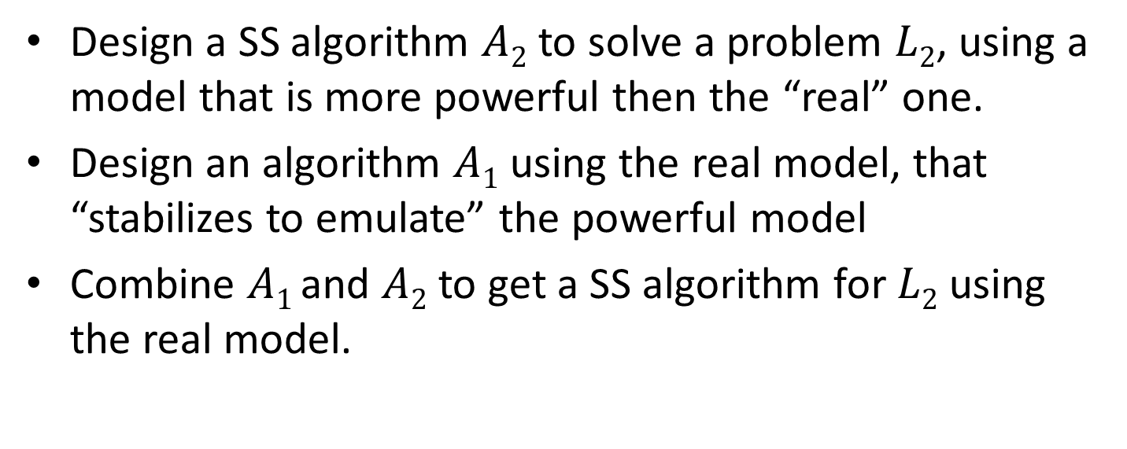
Self-stabilizing emulations
[Dolev, Chapter 4]
Design a SS algorithm $A2$ to solve a problem $L2$, using a model that is more powerful then the “real” one.
Design an algorithm $A1$ using the real model, that “stabilizes to emulate” the powerful model
Combine $A1$ and $A2$ to get a SS algorithm for $L2$ using the real model.
Notes:
Similar to composition.

Slide 44
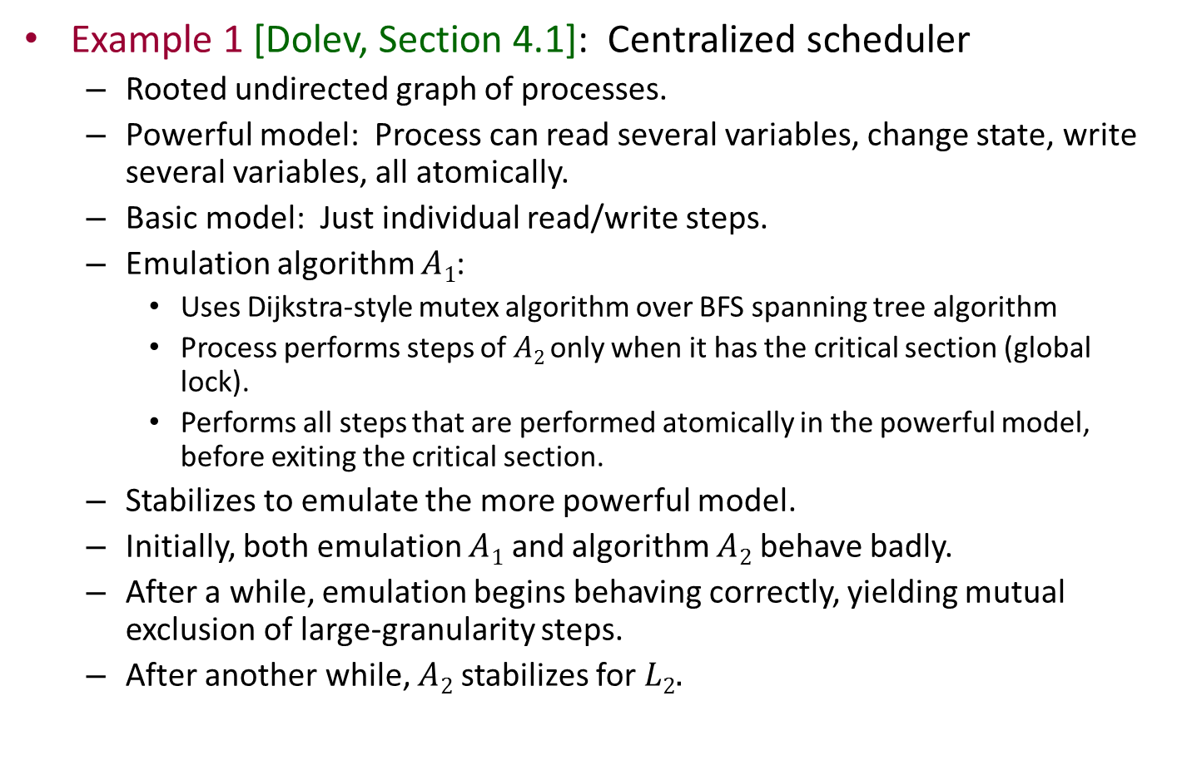
Self-stabilizing emulations
Example 1 [Dolev, Section 4.1]: Centralized scheduler
  Rooted undirected graph of processes.
  Powerful model: Process can read several variables, change state, write several variables, all atomically.
  Basic model: Just individual read/write steps.
  Emulation algorithm $A1$:
    Uses Dijkstra-style mutex algorithm over BFS spanning tree algorithm
    Process performs steps of $A2$ only when it has the critical section (global lock).
    Performs all steps that are performed atomically in the powerful model, before exiting the critical section.
  Stabilizes to emulate the more powerful model.
  Initially, both emulation $A1$ and algorithm $A2$ behave badly.
  After a while, emulation begins behaving correctly, yielding mutual exclusion of large-granularity steps.
  After another while, $A2$ stabilizes for $L2.$
Notes:
Similar to composition.
This strategy is very centralized. We emulate a distributed algorithm by means of a global lock.

Slide 45
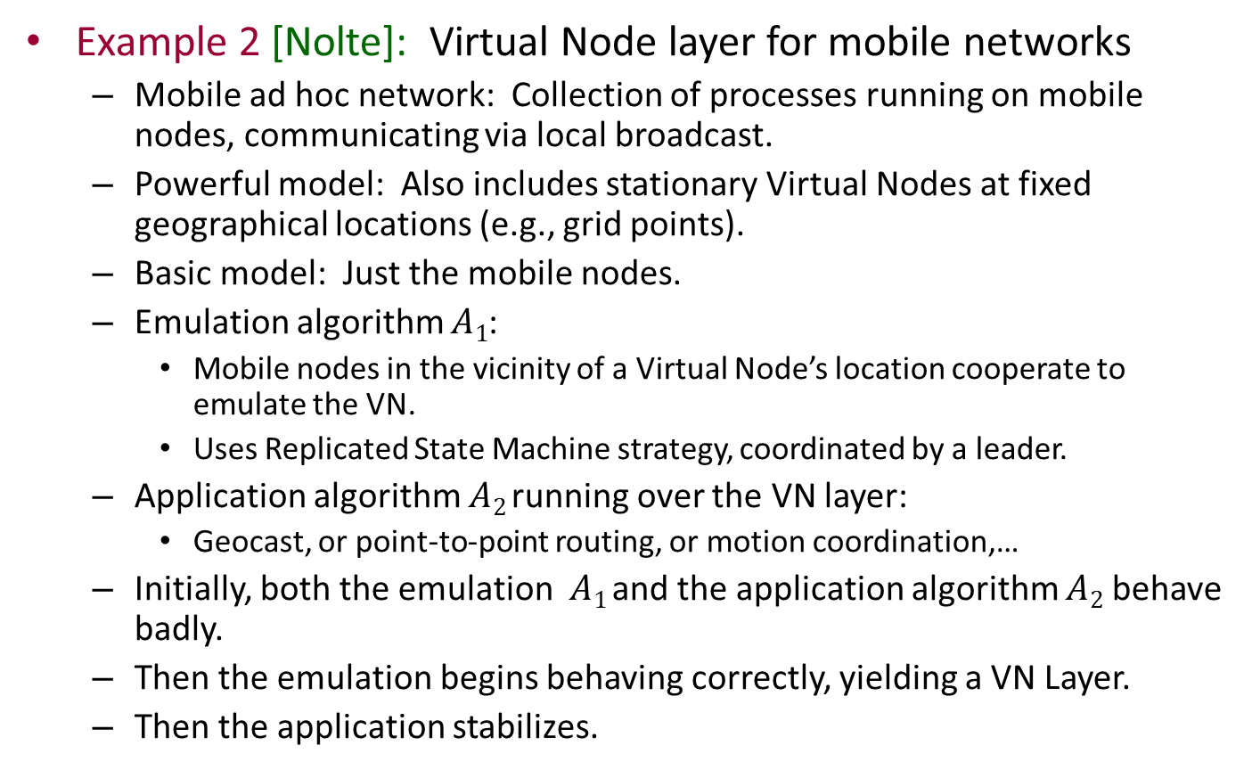
Self-stabilizing emulations
Example 2 [Nolte]: Virtual Node layer for mobile networks
  Mobile ad hoc network: Collection of processes running on mobile nodes, communicating via local broadcast.
  Powerful model: Also includes stationary Virtual Nodes at fixed geographical locations (e.g., grid points).
  Basic model: Just the mobile nodes.
  Emulation algorithm $A1$:
    Mobile nodes in the vicinity of a Virtual Node’s location cooperate to emulate the VN.
    Uses Replicated State Machine strategy, coordinated by a leader.
  Application algorithm $A2$ running over the VN layer:
    Geocast, or point-to-point routing, or motion coordination,…
  Initially, both the emulation $A1$ and the application algorithm $A2$ behave badly.
  Then the emulation begins behaving correctly, yielding a VN Layer.
  Then the application stabilizes.

Slide 46
Making Non-Self-Stabilizing Algorithms Self-Stabilizing

Slide 47
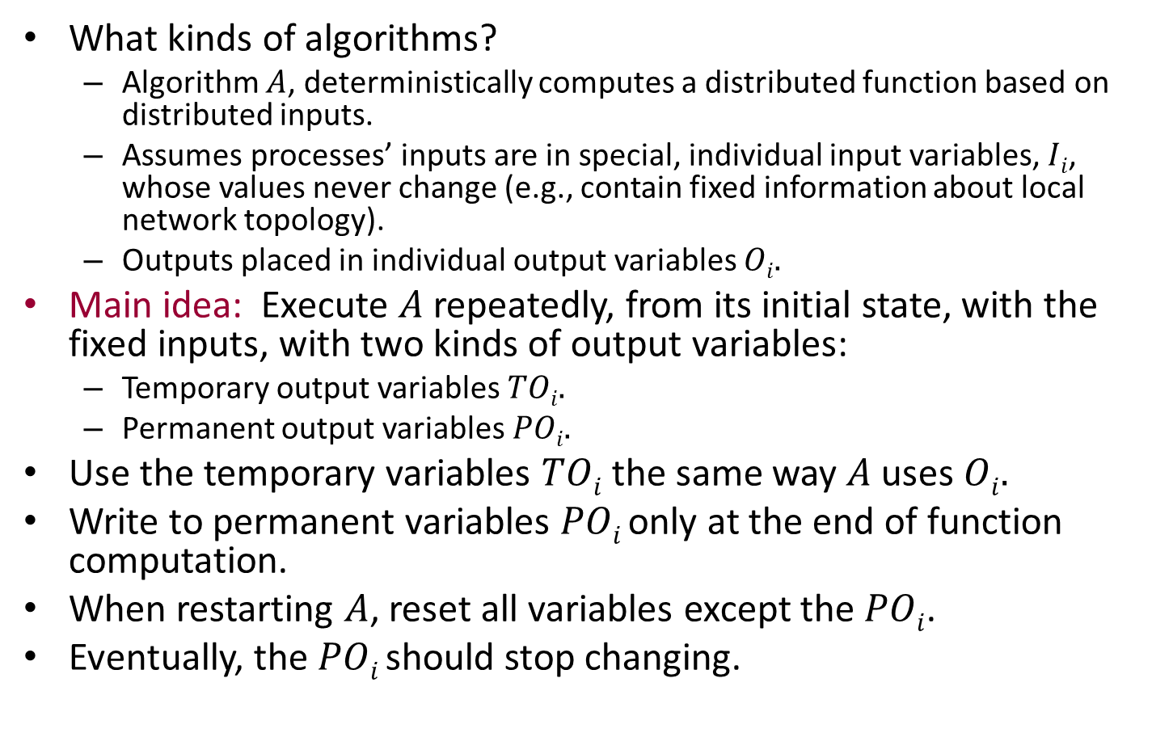
Making non-SS algorithms SS
[Dolev, Section 2.8]
What kinds of algorithms?
  Algorithm $A$, deterministically computes a distributed function based on distributed inputs.
  Assumes processes’ inputs are in special, individual input variables, $Ii$, whose values never change (e.g., contain fixed information about local network topology).
  Outputs placed in individual output variables $Oi.$
Main idea: Execute $A$ repeatedly, from its initial state, with the fixed inputs, with two kinds of output variables:
  Temporary output variables $TOi.$
  Permanent output variables $POi.$
Use the temporary variables $TOi$the same way $A$uses $Oi.$
Write to permanent variables $POi$only at the end of function computation.
When restarting $A$, reset all variables except the $POi$.
Eventually, the $POi$should stop changing.
Notes:
A may change the output variables during the course of the algorithm, not just at the end.

Slide 48
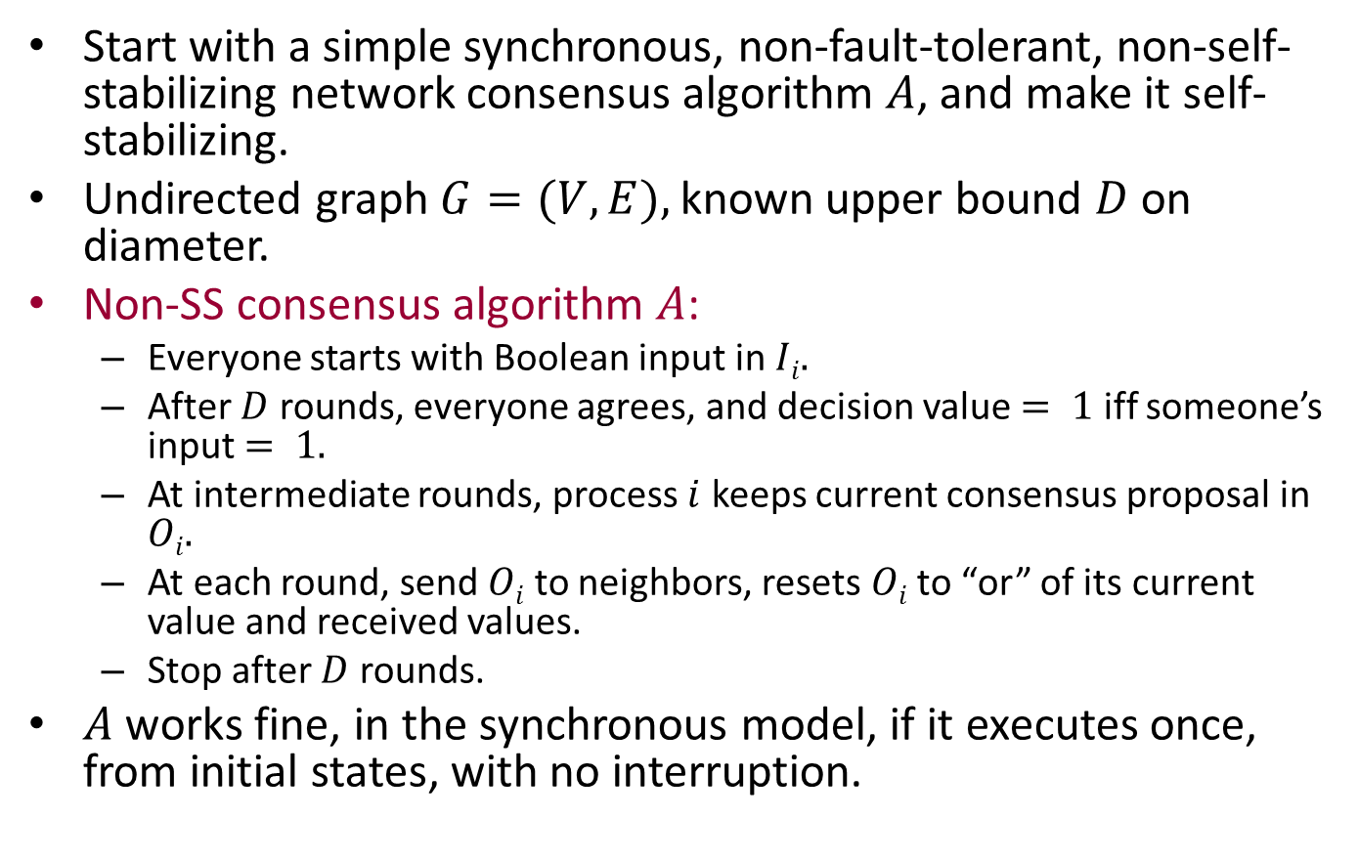
Example: Consensus
Start with a simple synchronous, non-fault-tolerant, non-self-stabilizing network consensus algorithm $A$, and make it self-stabilizing.
Undirected graph $G=(V,E),$known upper bound $D$ on diameter.
Non-SS consensus algorithm $A$:
  Everyone starts with Boolean input in $Ii.$
  After $D$ rounds, everyone agrees, and decision value $= 1$ iff someone’s input $= 1.$
  At intermediate rounds, process $i$ keeps current consensus proposal in $Oi.$
  At each round, send $Oi$ to neighbors, resets $Oi$ to “or” of its current value and received values.
  Stop after $D$ rounds.
$A$ works fine, in the synchronous model, if it executes once, from initial states, with no interruption.

Slide 49
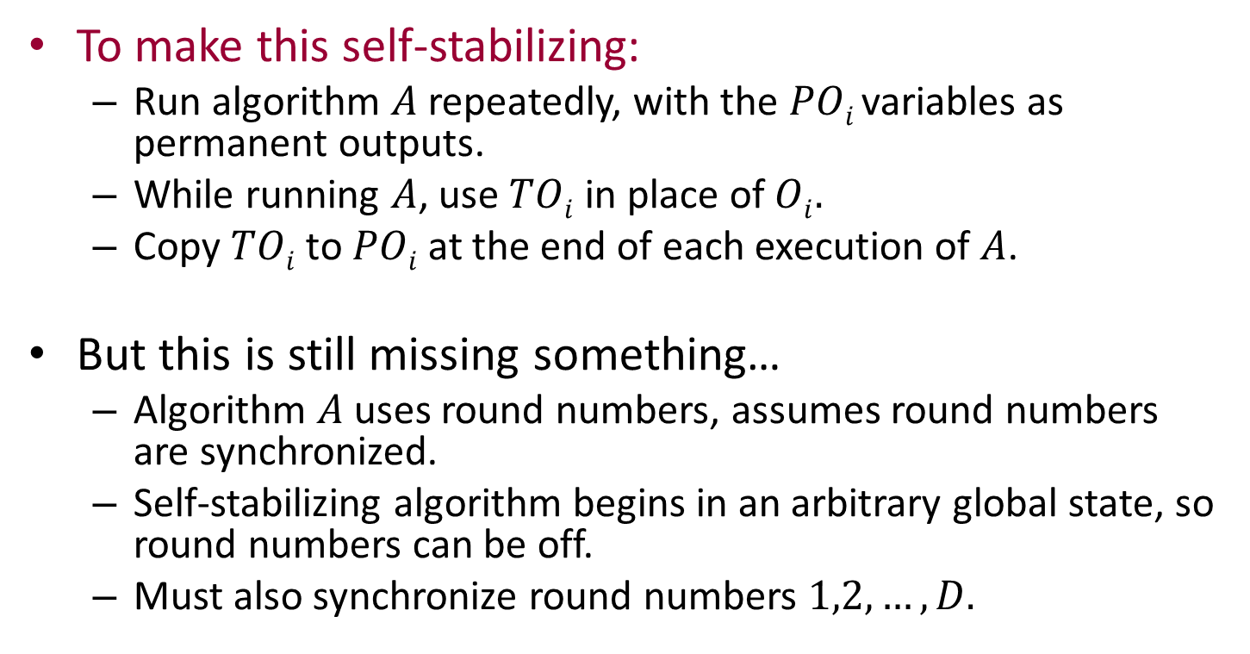
Example: Consensus
To make this self-stabilizing:
  Run algorithm $A$ repeatedly, with the $POi$variables as permanent outputs.
  While running $A$, use $TOi$ in place of $Oi.$
  Copy $TOi$ to $POi$at the end of each execution of $A$.
But this is still missing something…
  Algorithm $A$uses round numbers, assumes round numbers are synchronized.
  Self-stabilizing algorithm begins in an arbitrary global state, so round numbers can be off.
  Must also synchronize round numbers $1,2,…,D.$

Slide 50
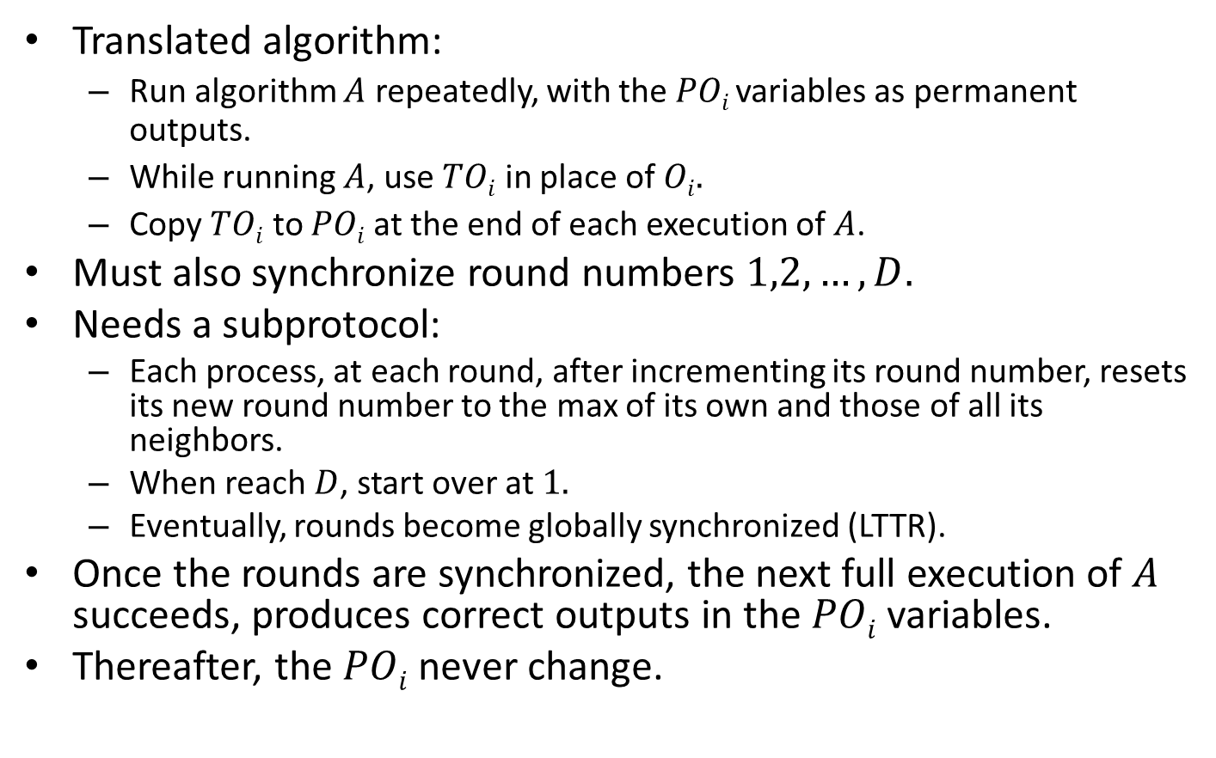
Example: Consensus
Translated algorithm:
  Run algorithm $A$ repeatedly, with the $POi$variables as permanent outputs.
  While running $A$, use $TOi$ in place of $Oi.$
  Copy $TOi$ to $POi$at the end of each execution of $A$.
Must also synchronize round numbers $1,2,…,D.$
Needs a subprotocol:
  Each process, at each round, after incrementing its round number, resets its new round number to the max of its own and those of all its neighbors.
  When reach $D$, start over at $1.$
  Eventually, rounds become globally synchronized (LTTR).
Once the rounds are synchronized, the next full execution of $A$ succeeds, produces correct outputs in the $POi$ variables.
Thereafter, the $POi$never change.
Notes:
This can be seen as another example of a self-stabilizing emulation.
Eventually the system is simulating the synchronous model.
Thereafter, it eventually stabilizes to correct consensus execution.

Slide 51
Extensions
Can make this into a fairly general transformation, for synchronous algorithms.
Using synchronizers, can even extend this to some asynchronous algorithms.

Slide 52
Making non-SS algorithms SS: Monitoring and Resetting [Section 5.2]
AKA Checking and Correction.
Assumes message-passing model.
Basic idea:
  Continually monitor the consistency of the underlying algorithm.
  Repair the algorithm when inconsistency is detected.
Global monitoring and resetting:
  Use a SS leader election service to choose a leader (if there isn’t a stable distinguished process).
  Leader repeatedly conducts global snapshots, checks consistency, and sends out corrections if necessary.
Local monitoring and resetting [Varghese thesis, 92]
  For some algorithms, can check and restore local consistency predicates.
  E.g., BFS: Can check that local distance is one more than parent’s distance, recalculate dist and parent if not.

Slide 53
Other stuff in the book
Discussion of practical motivations.
Proof methods for showing SS.
Stabilizing to an abstract specification.
Model conversions, for SS algorithms:
  Shared memory → message-passing
  Synchronous → asynchronous
SS in presence of ongoing failures.
  Stopping, Byzantine, message loss.
Efficient “local” SS algorithms.
Many more algorithm examples.

Slide 54
Next time…
Insect colony algorithms (Mira Radeva)
Readings:
  Ghaffari, Lynch, Musco, Radeva paper on insect colony house-hunting algorithms.

Slide 55

Presentation Day
Friday, December 11, 10AM until done.
15 minute presentations
Lunch!

Slide 56
ONLINE SUBJECT EVALUATIONS
ARE NOW OPEN
http://web.mit.edu/subjectevaluation
You have until Monday, December 14 at 9am
Please evaluate all subjects in your list
Don’t forget your TAs
Write comments
Your feedback is read and valued!

